Slide 1
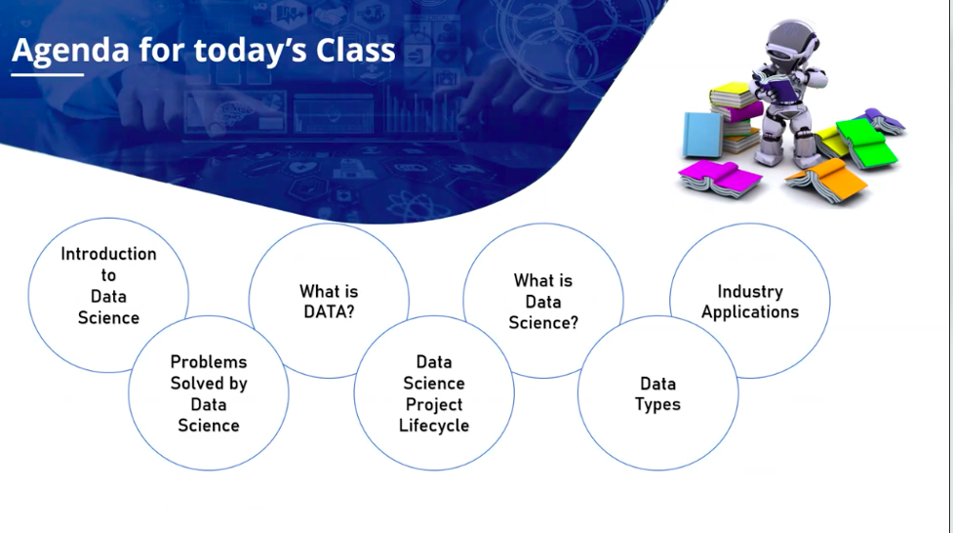

Slide 2
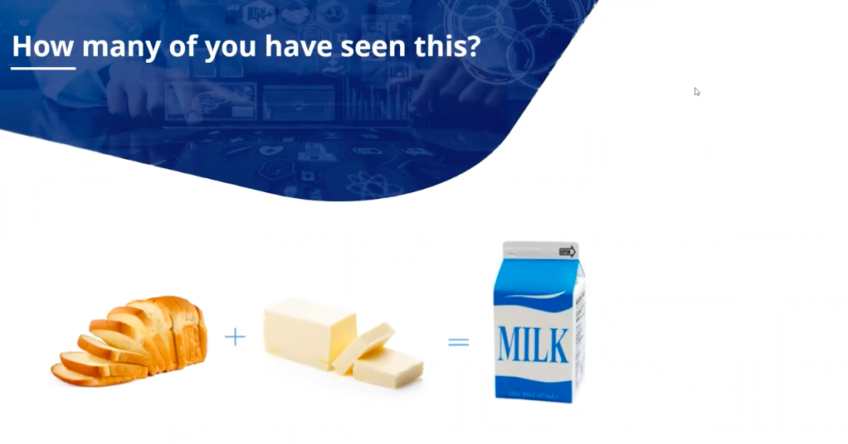

Slide 3
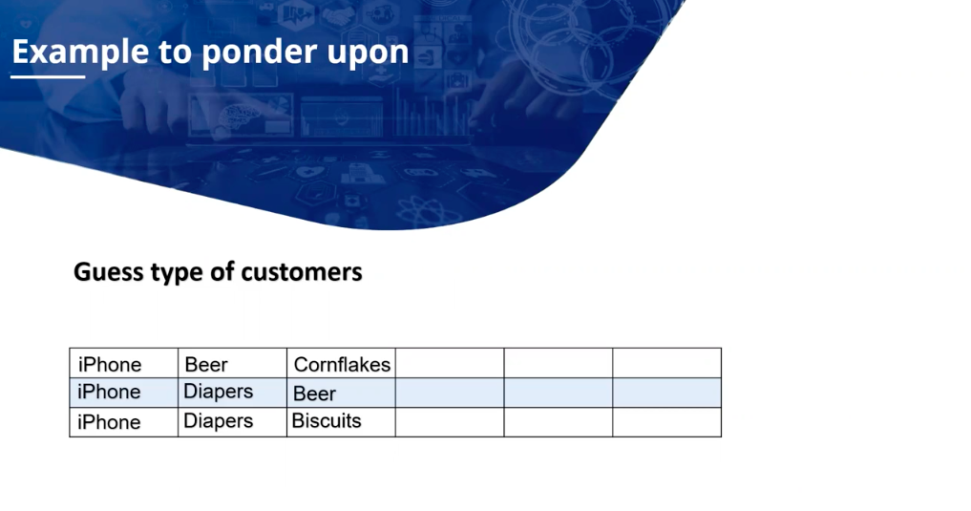

Slide 4
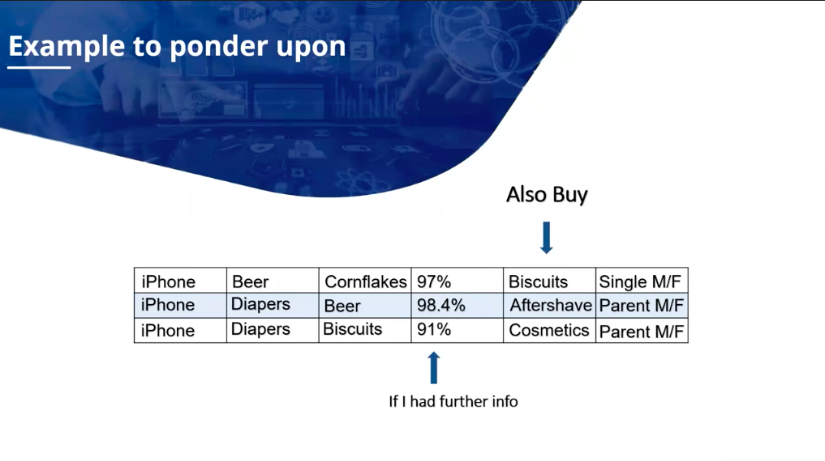

Slide 5


Slide 6
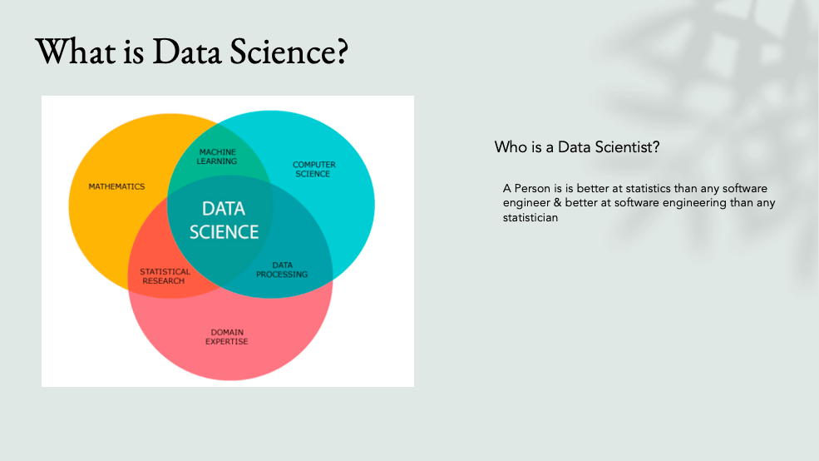

Slide 7
INTRODUCTION TO
STATISTICS

Slide 8
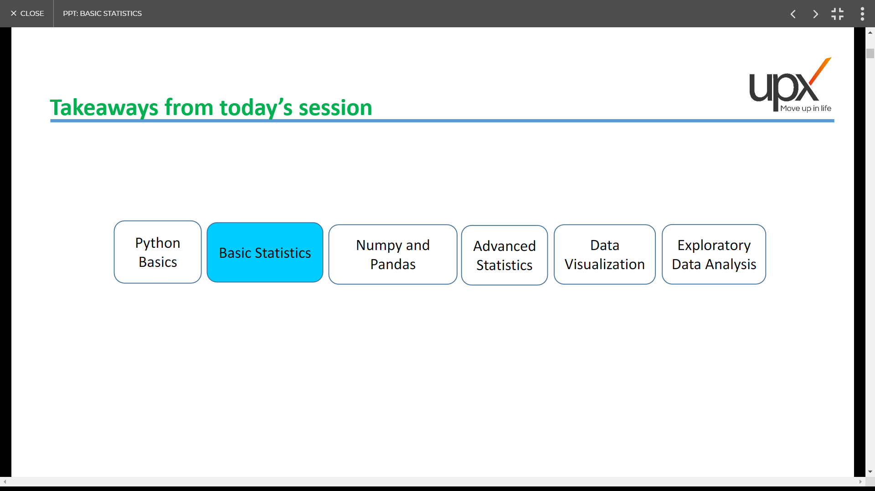
Takeaways from todays session

Slide 9
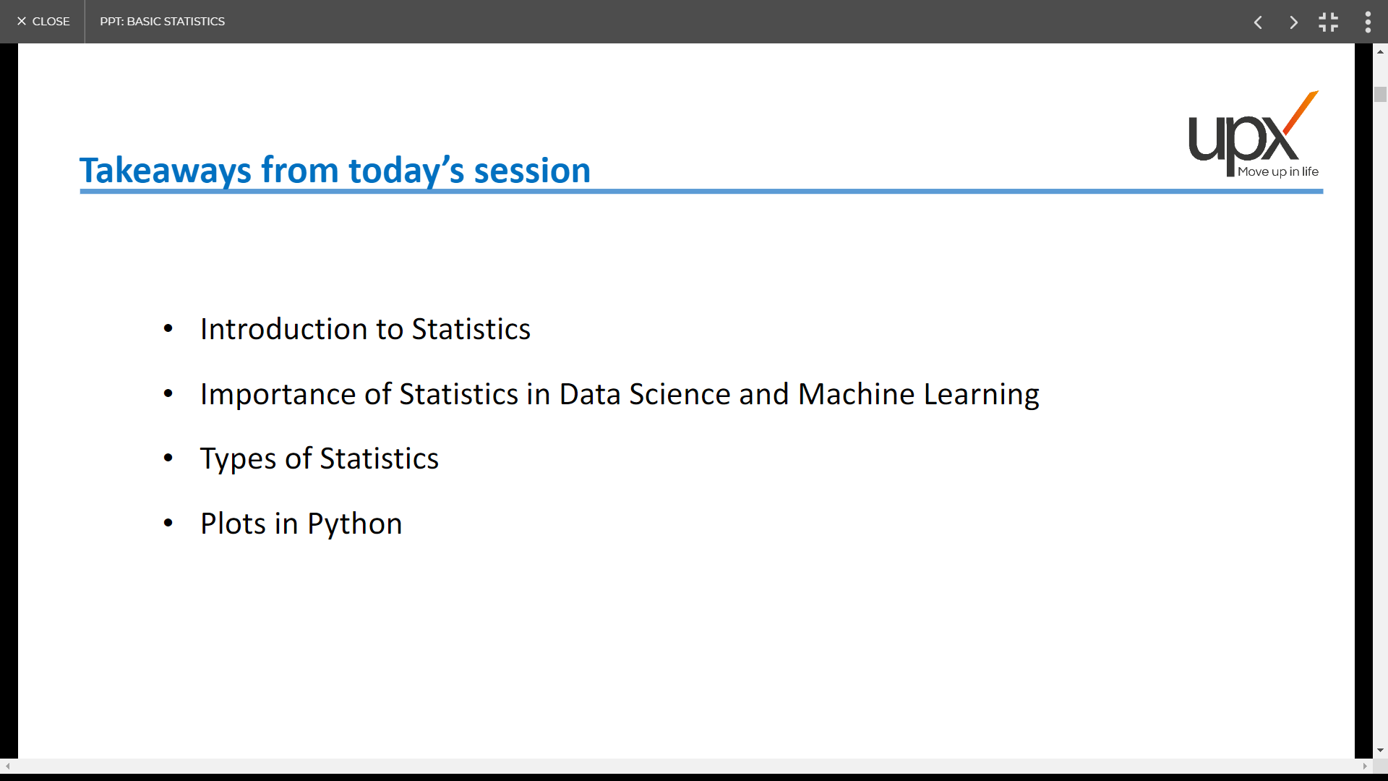
Takeaways from todays session

Slide 10
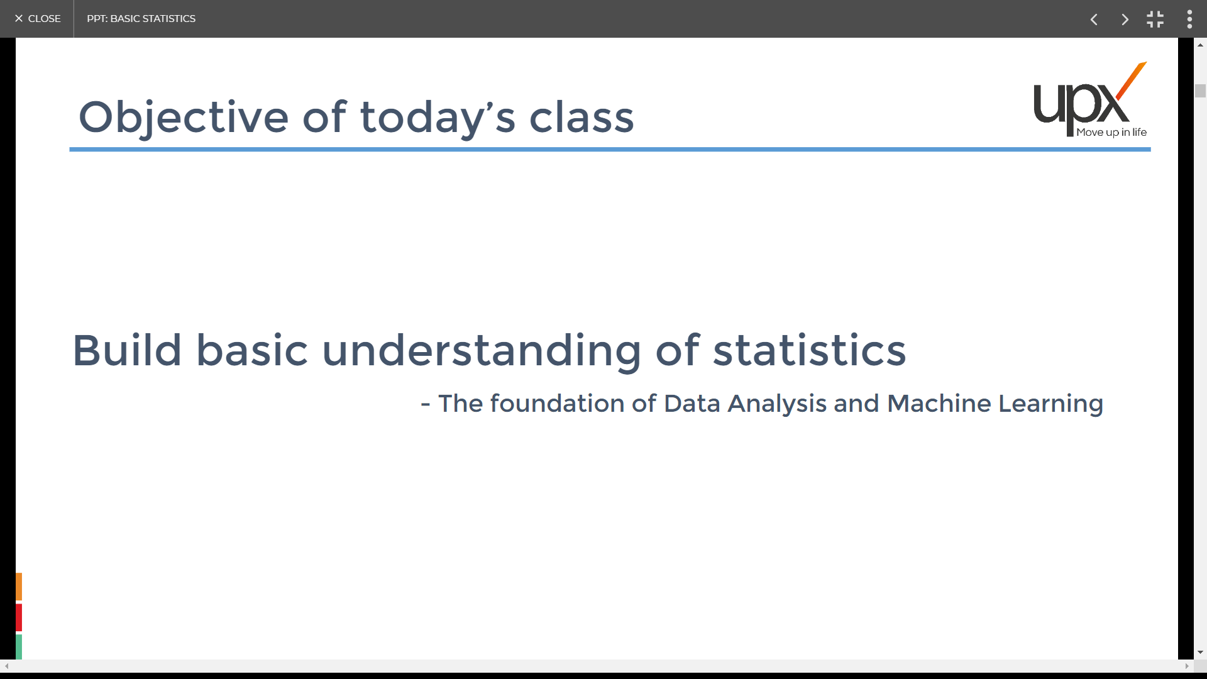
Objective of todays class

Slide 11
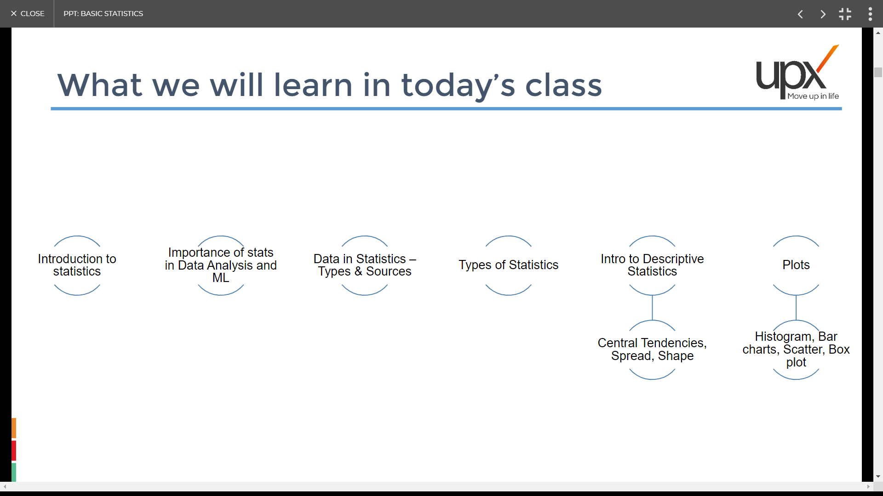
What we will learn from today’s class

Slide 12
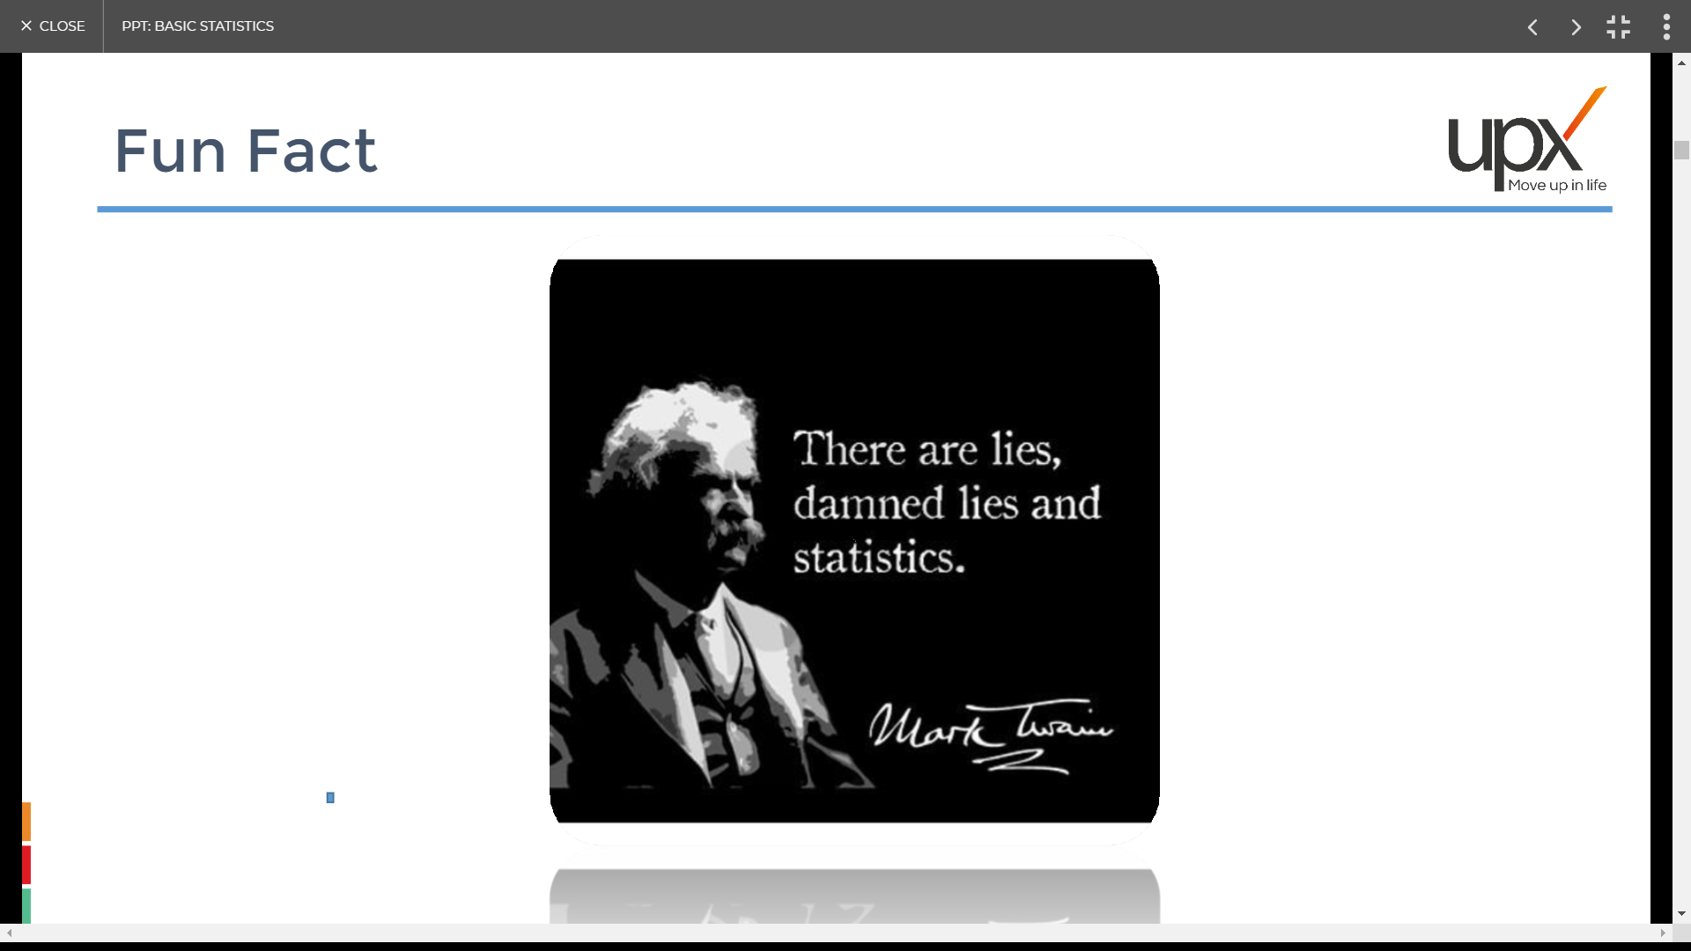
Fun Fact

Slide 13
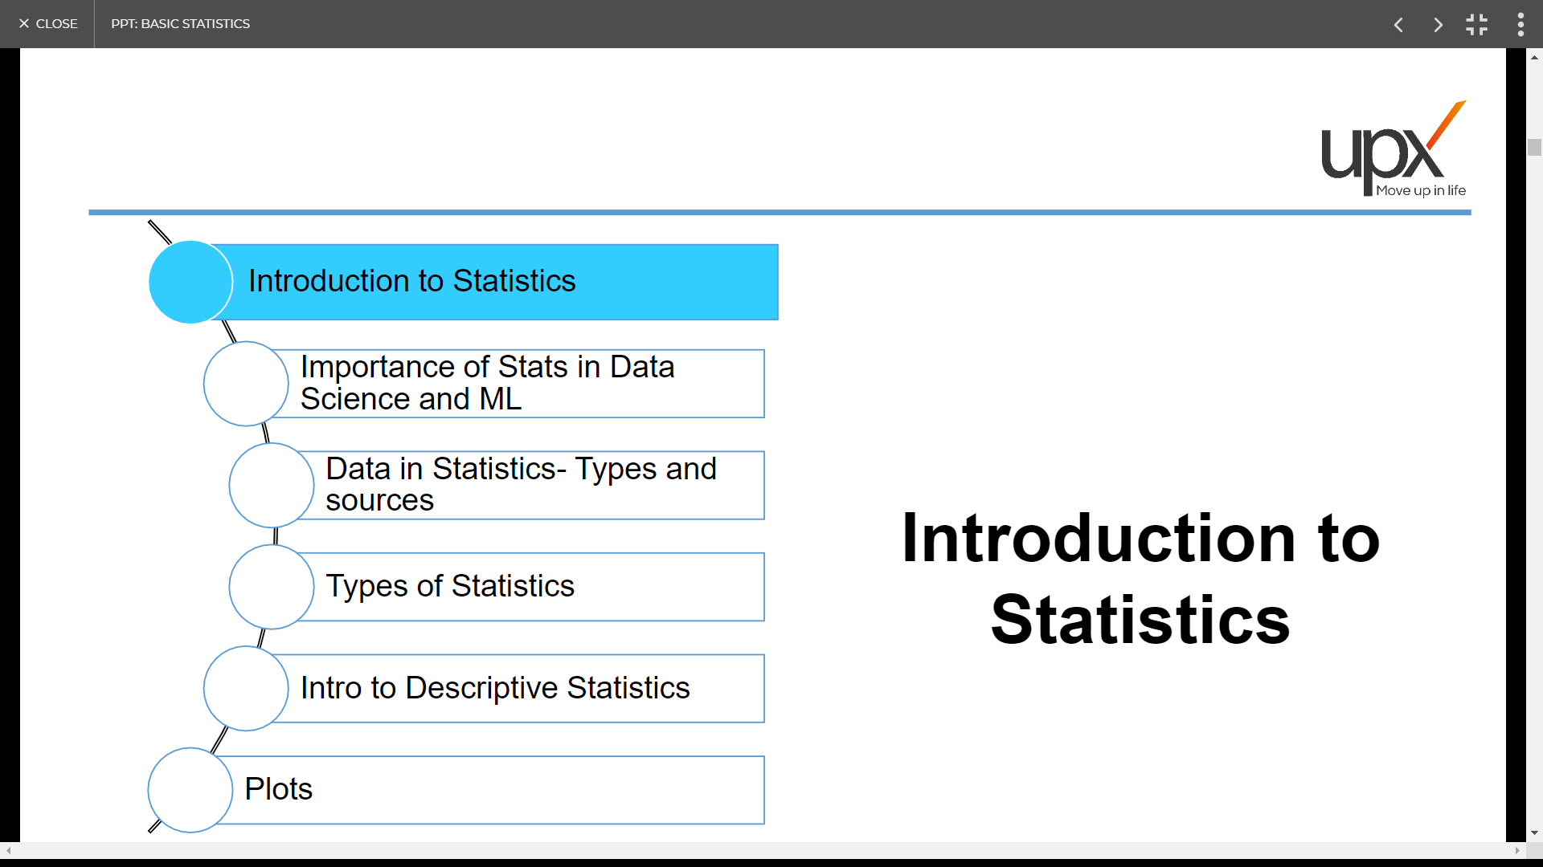

Slide 14
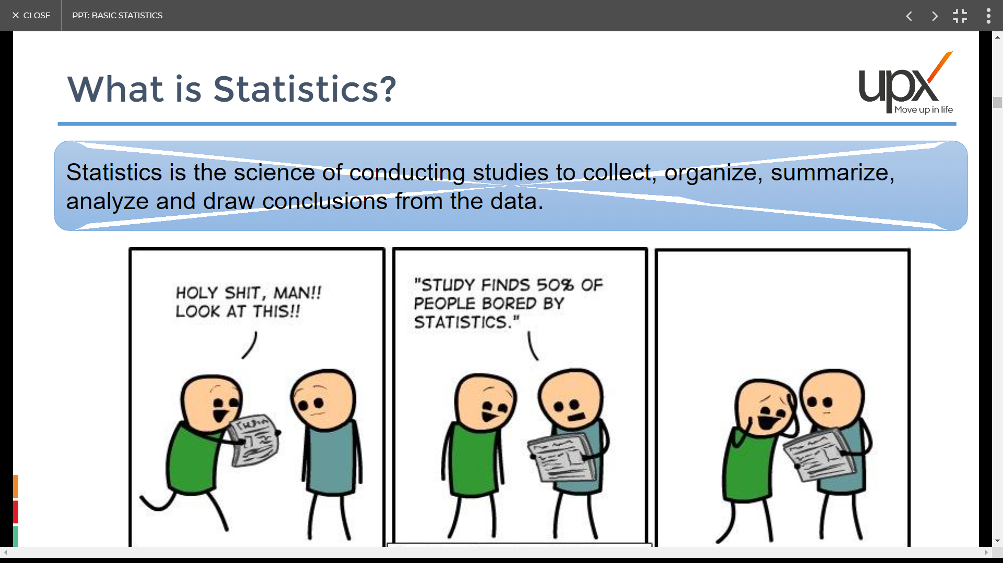
What is Statistics?

Slide 15
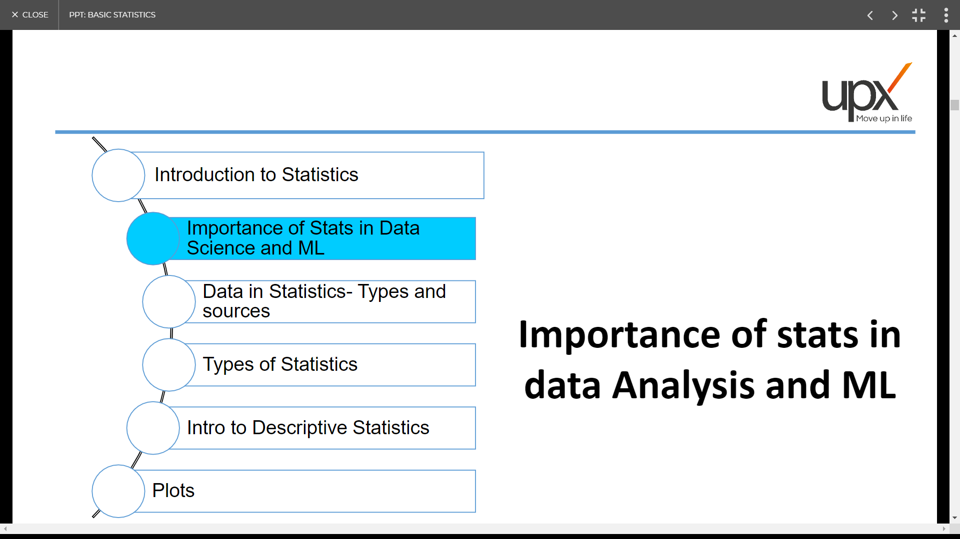

Slide 16
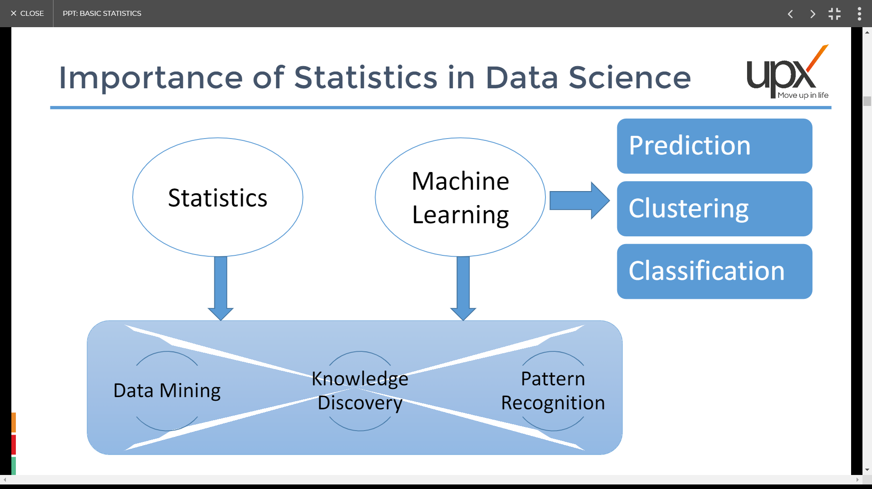
Importance of Statistics in Data Science
Data
Mining
Knowledge
Discovery
Pattern
Recognition

Slide 17
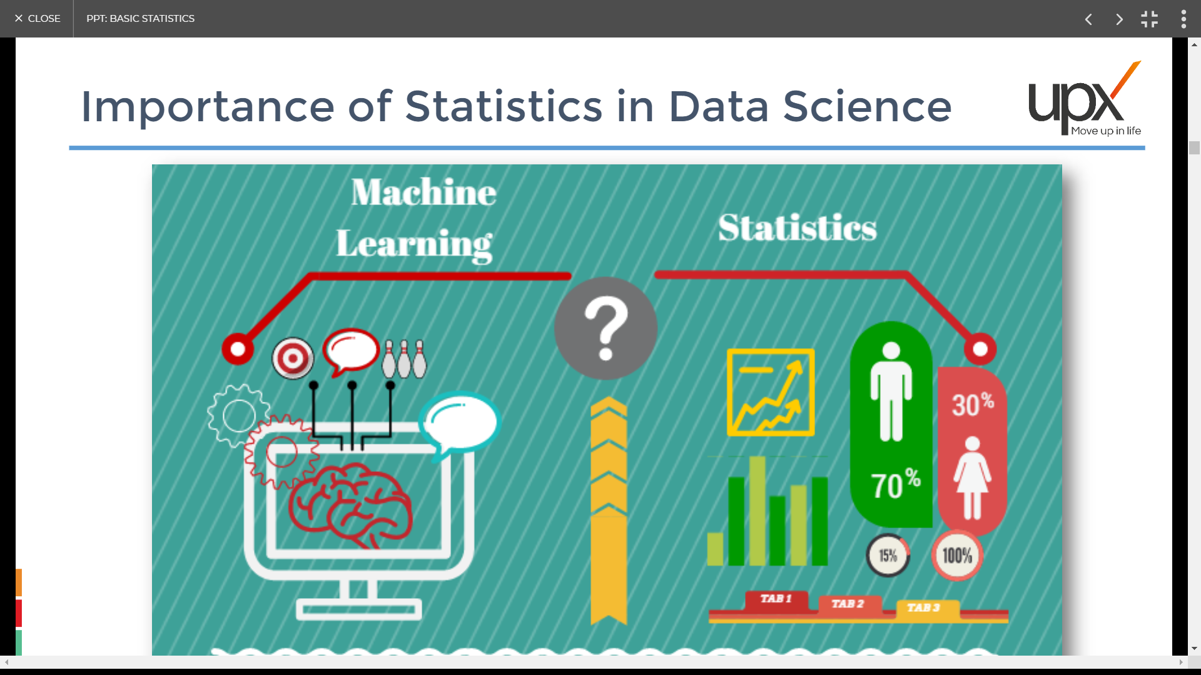
Importance of Statistics in Data Science

Slide 18
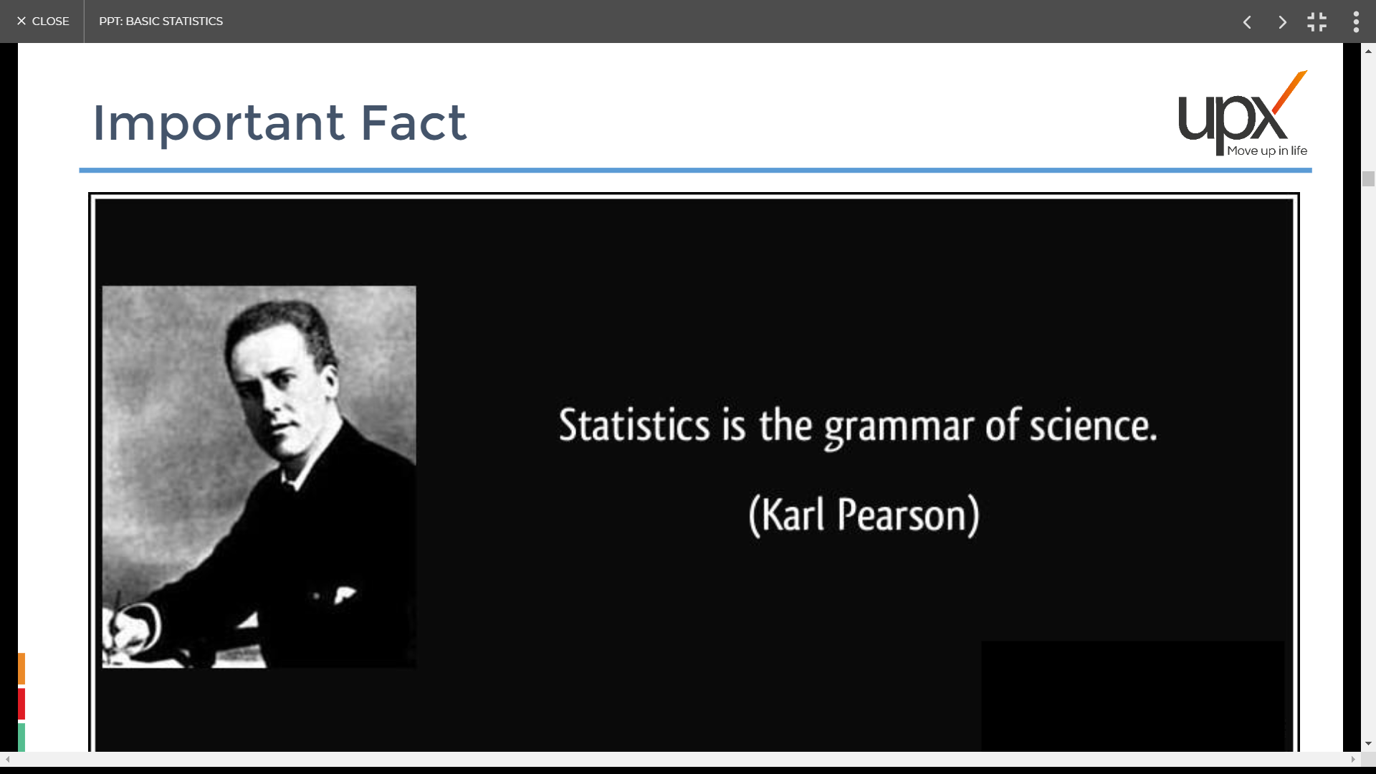
Important Fact

Slide 19
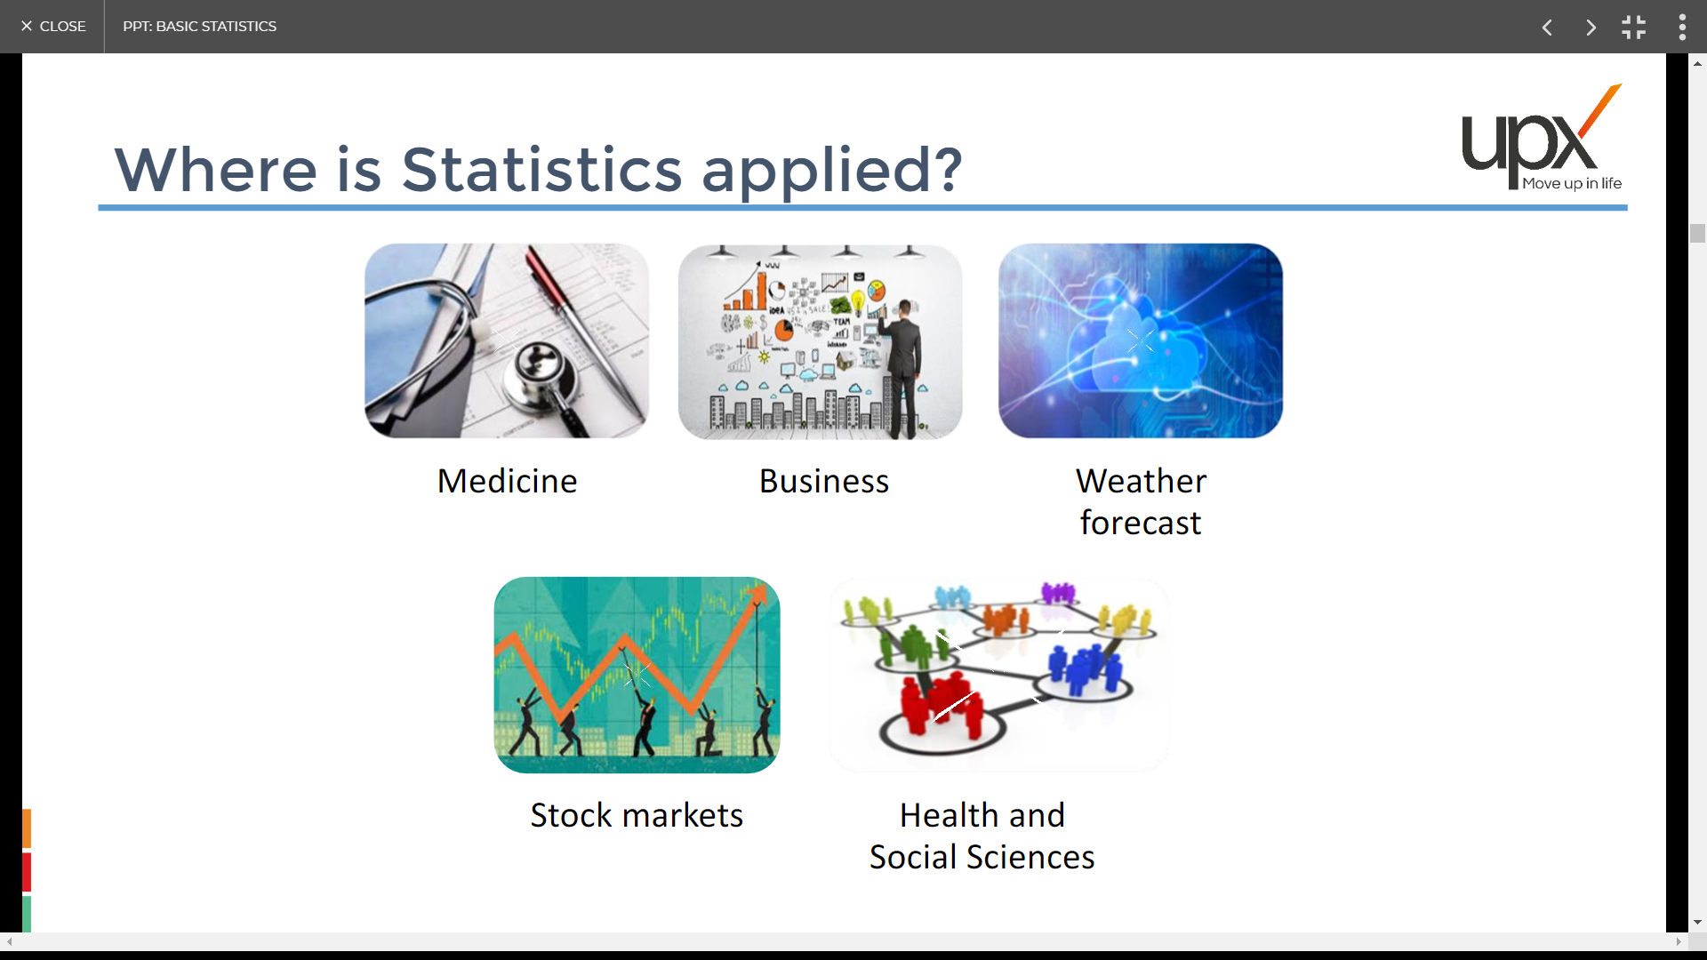
Where is Statistics applied?

Slide 20
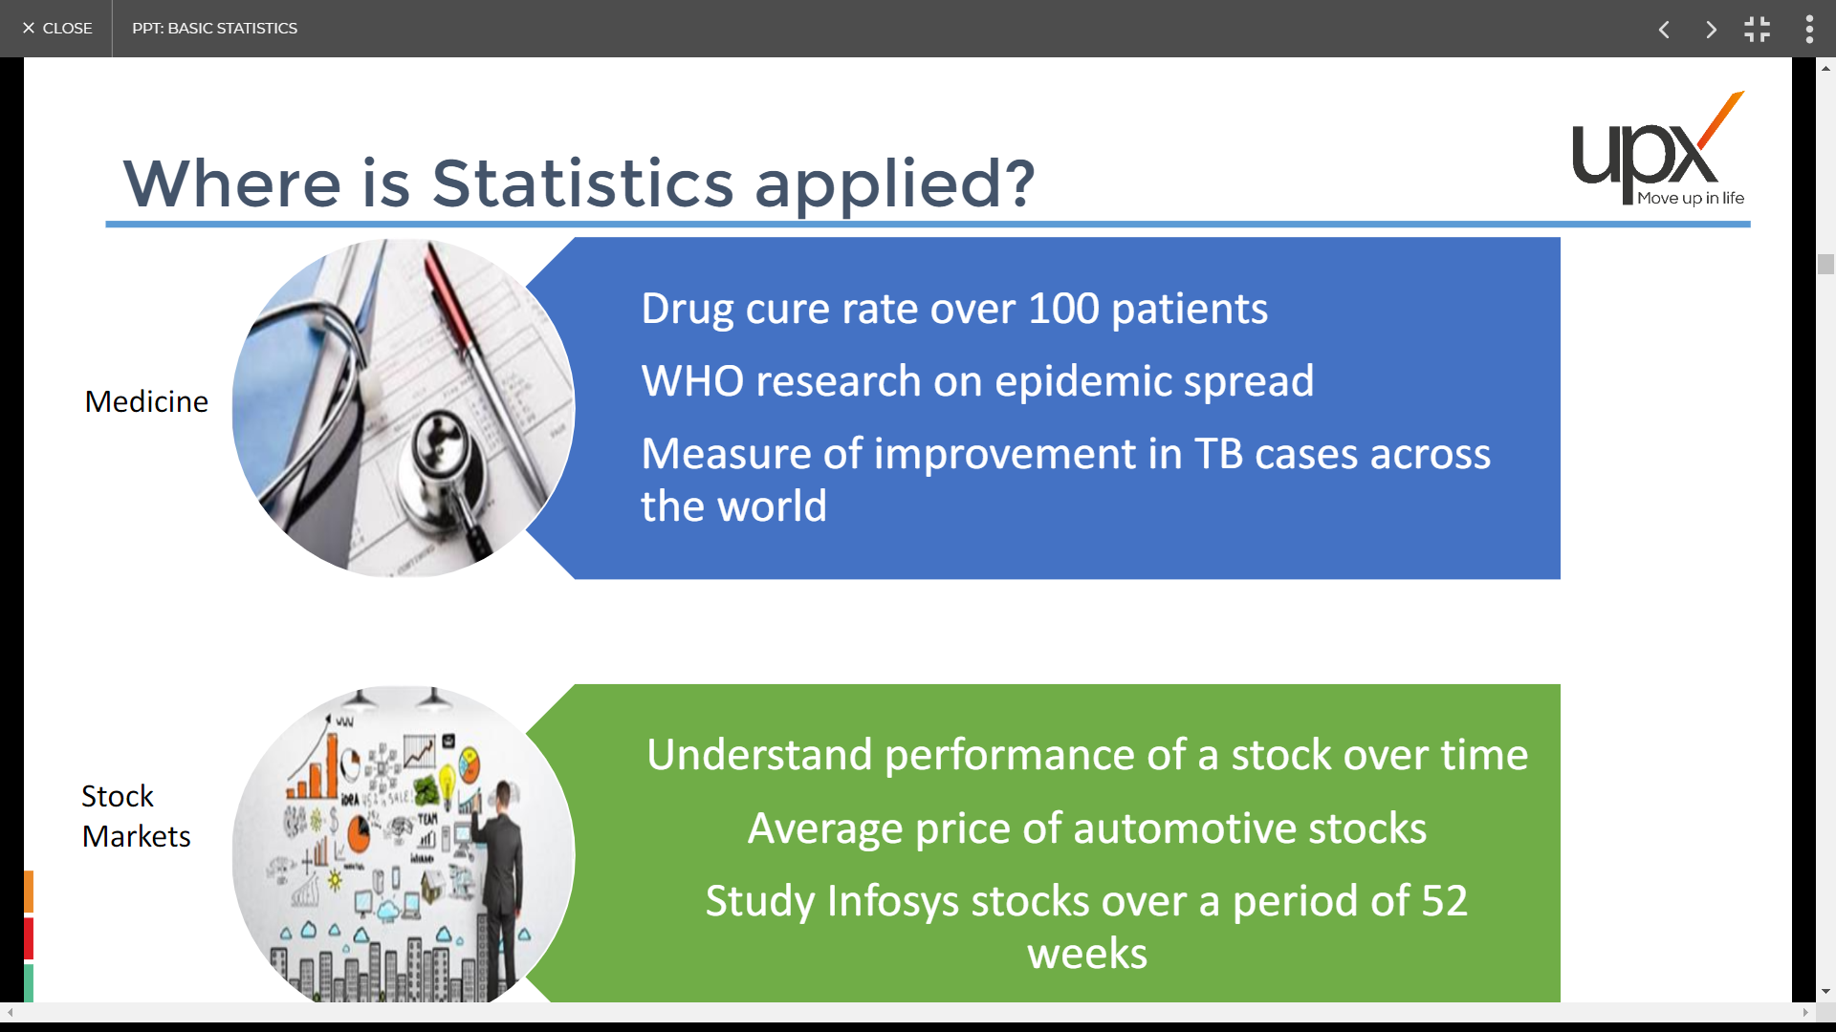
Where is Statistics applied?

Slide 21
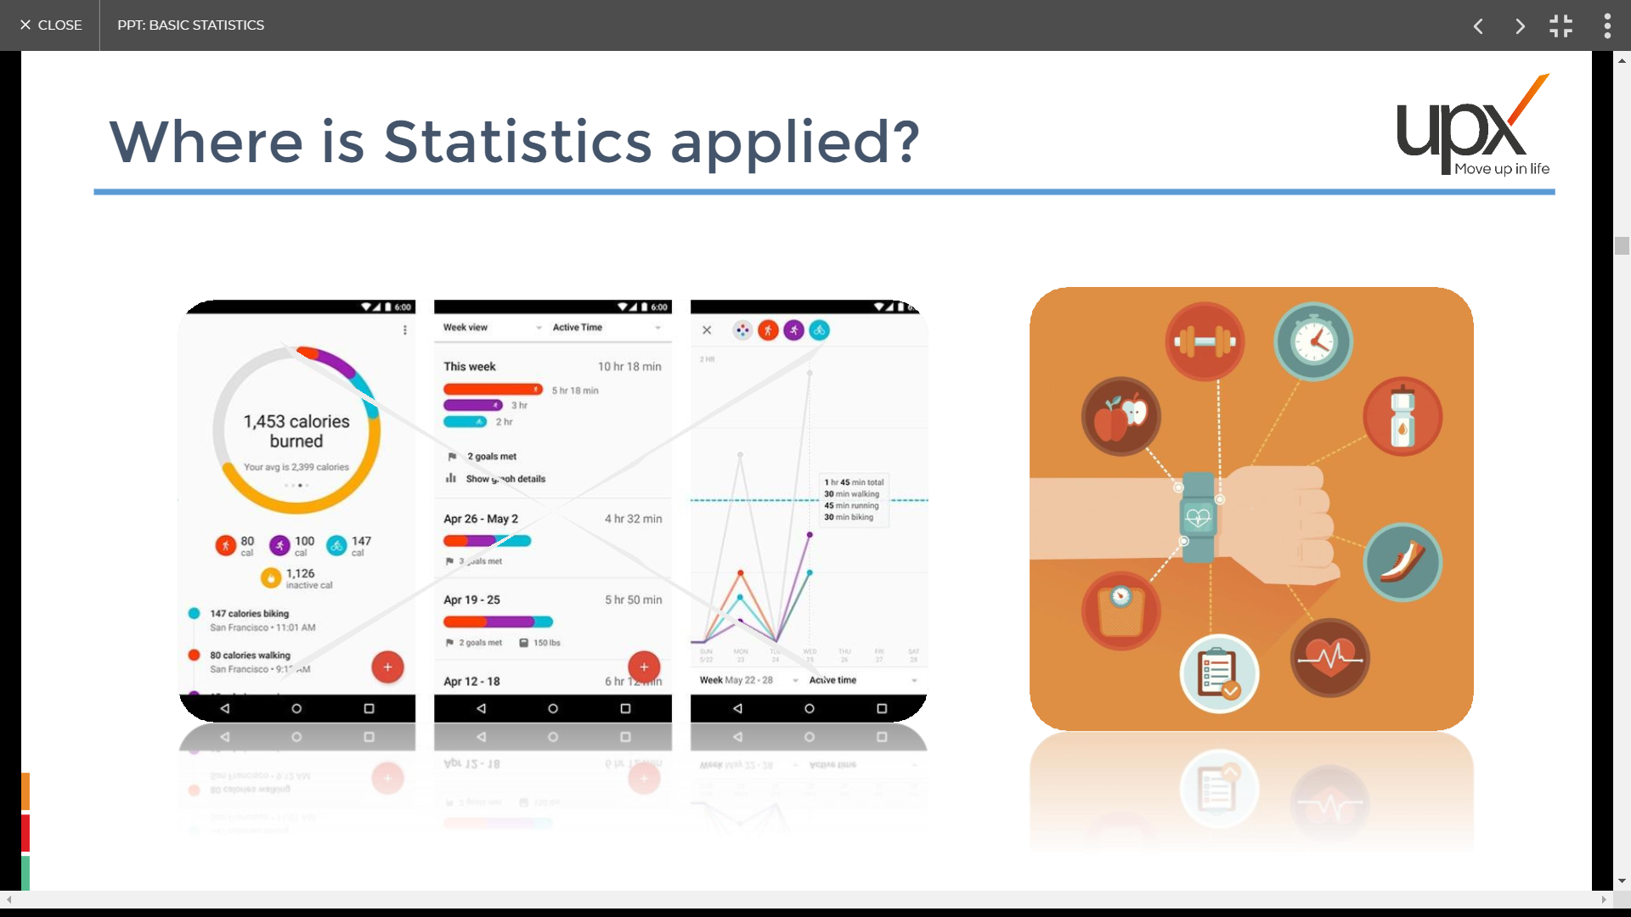
Where is Statistics applied?

Slide 22
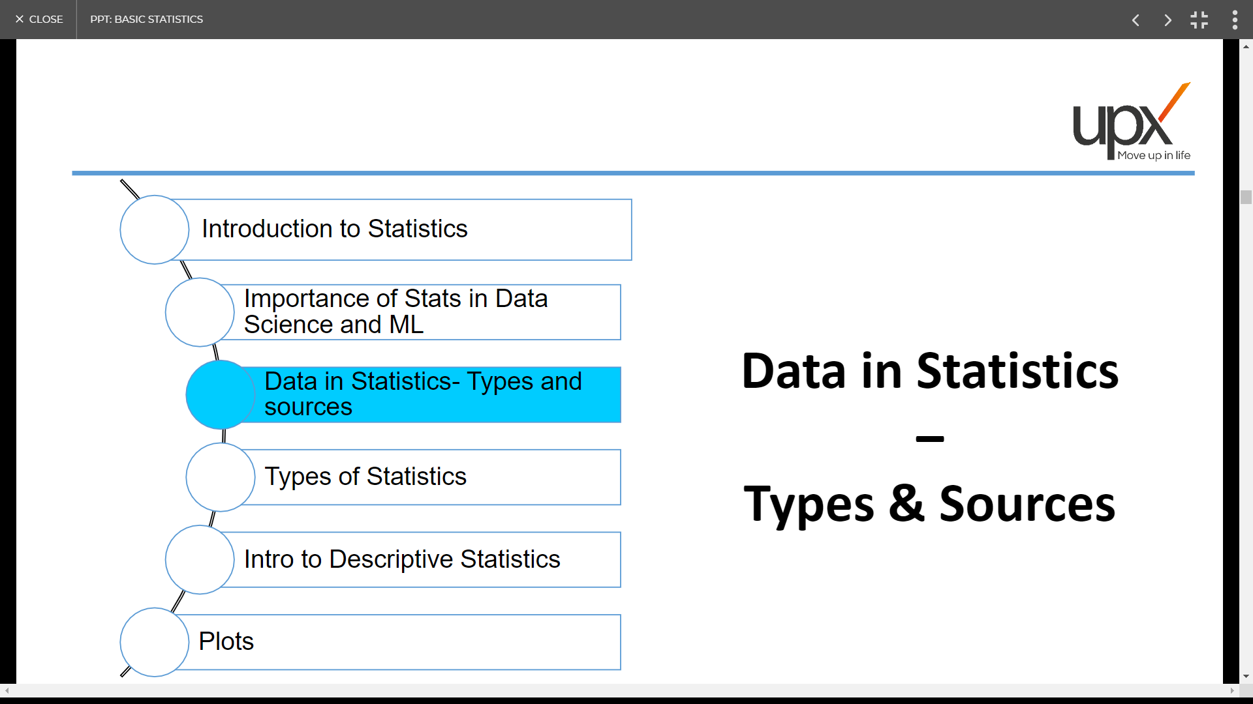

Slide 23
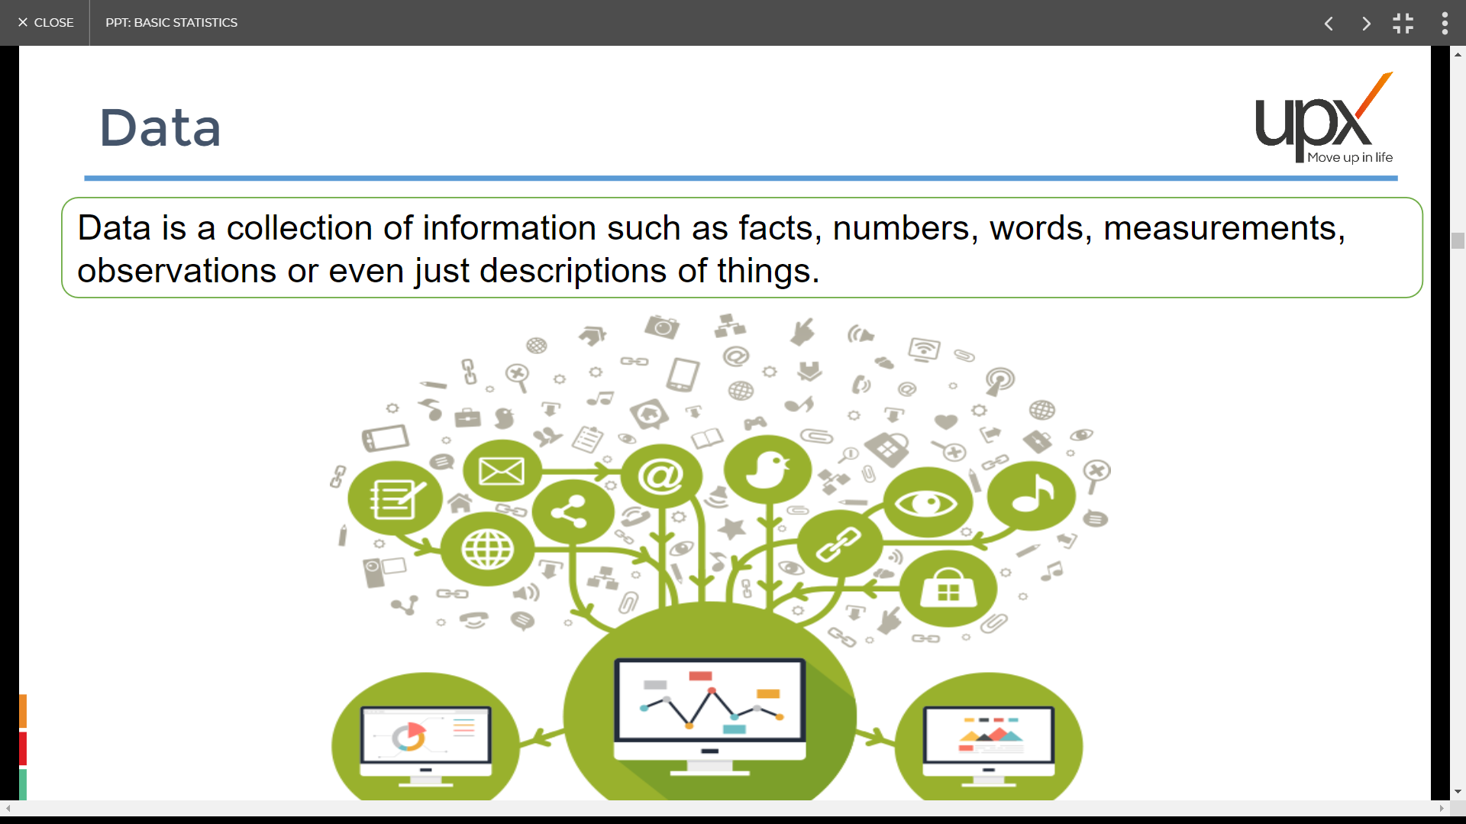
Data

Slide 24
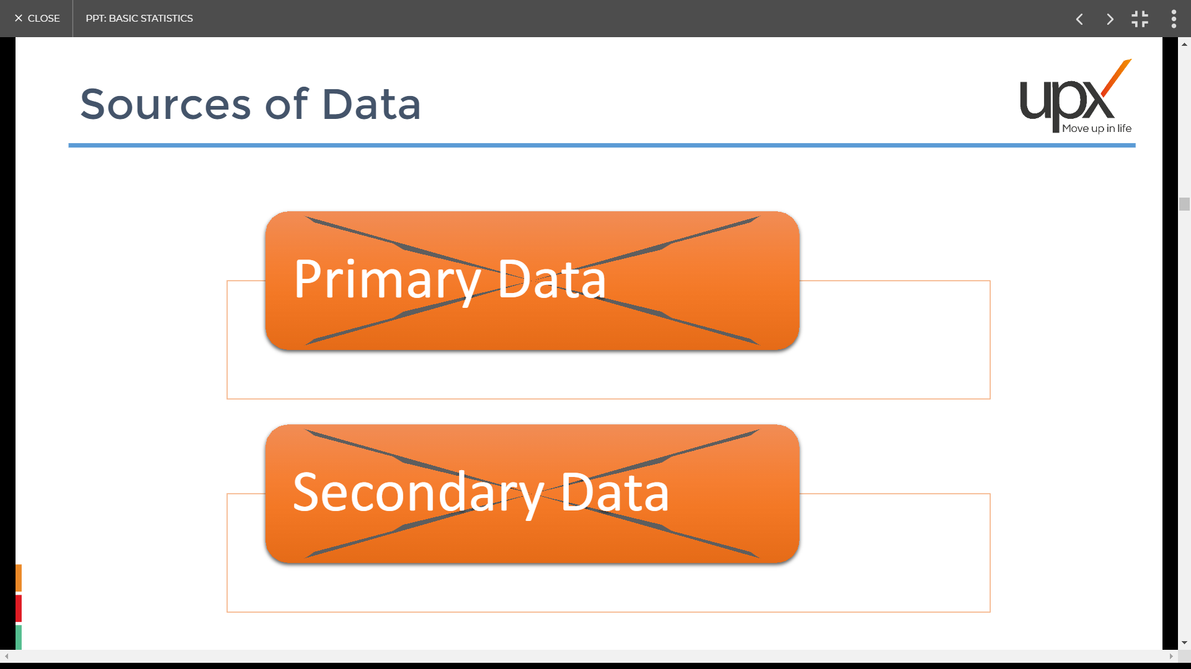
Sources of Data
Primary Data
Secondary Data

Slide 25
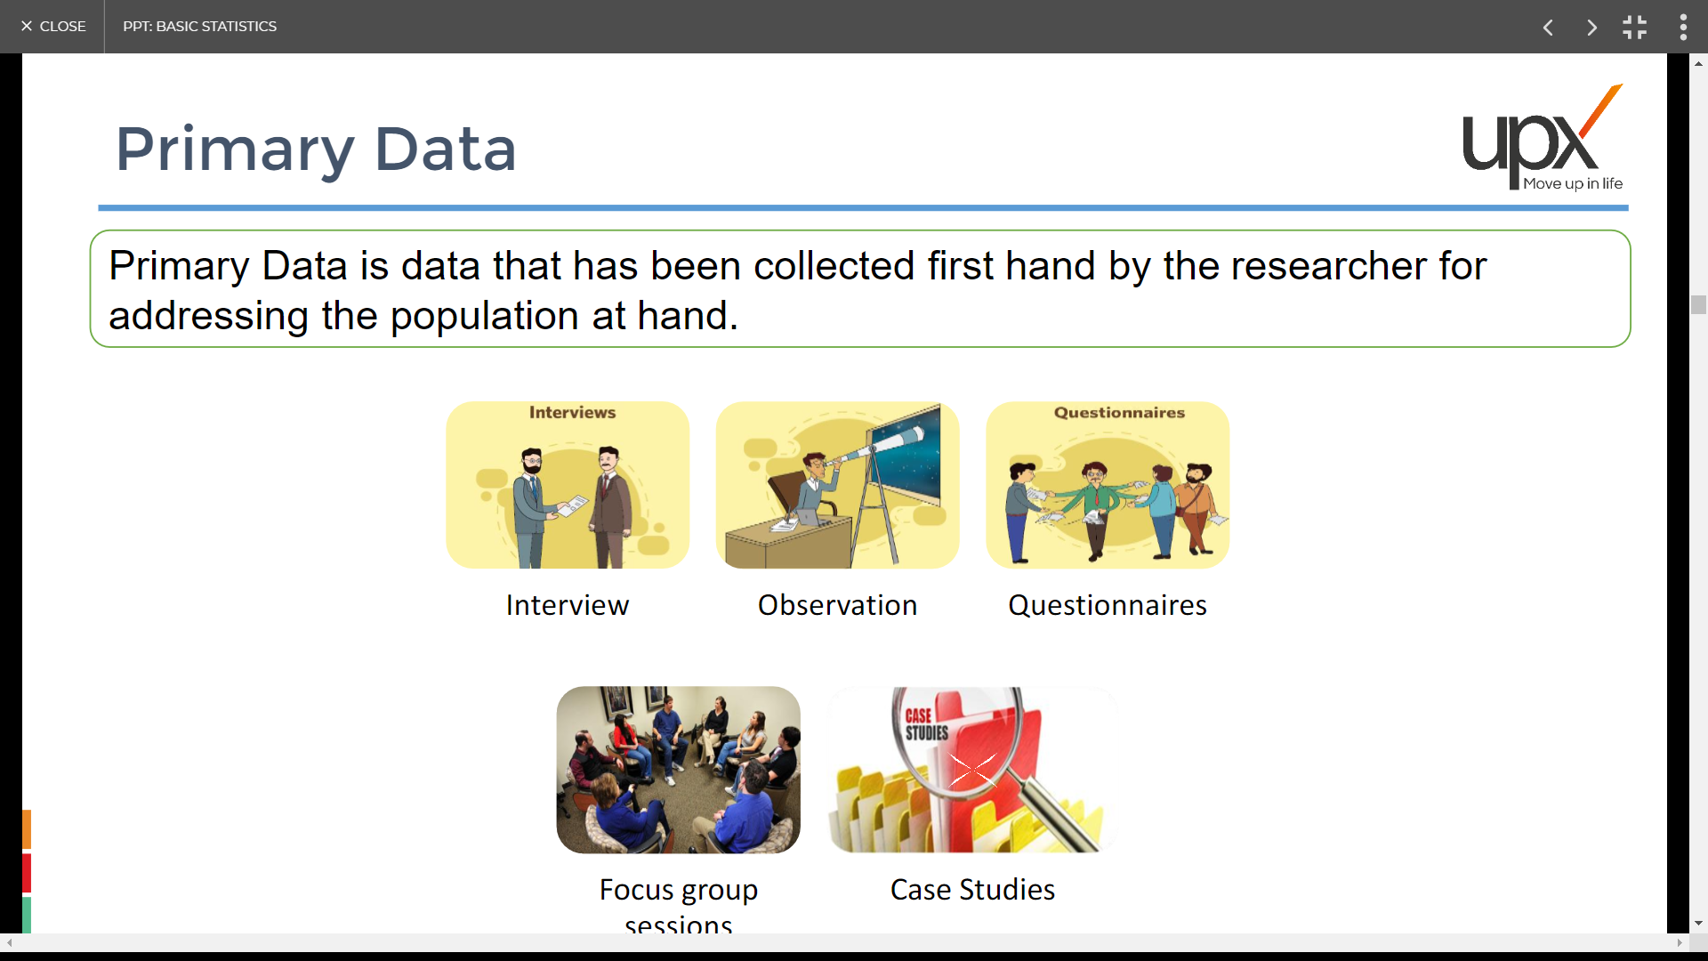
Primary Data
sessions

Slide 26
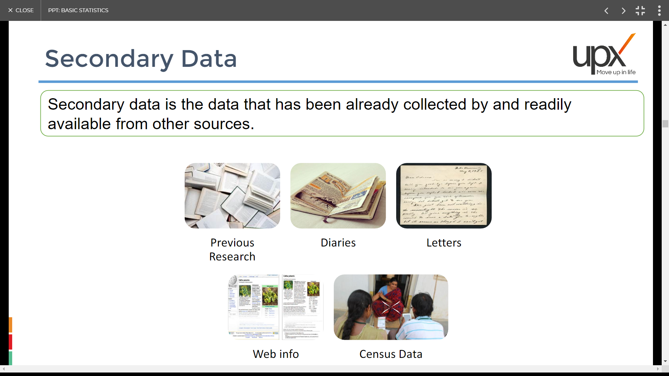
Secondary Data

Slide 27
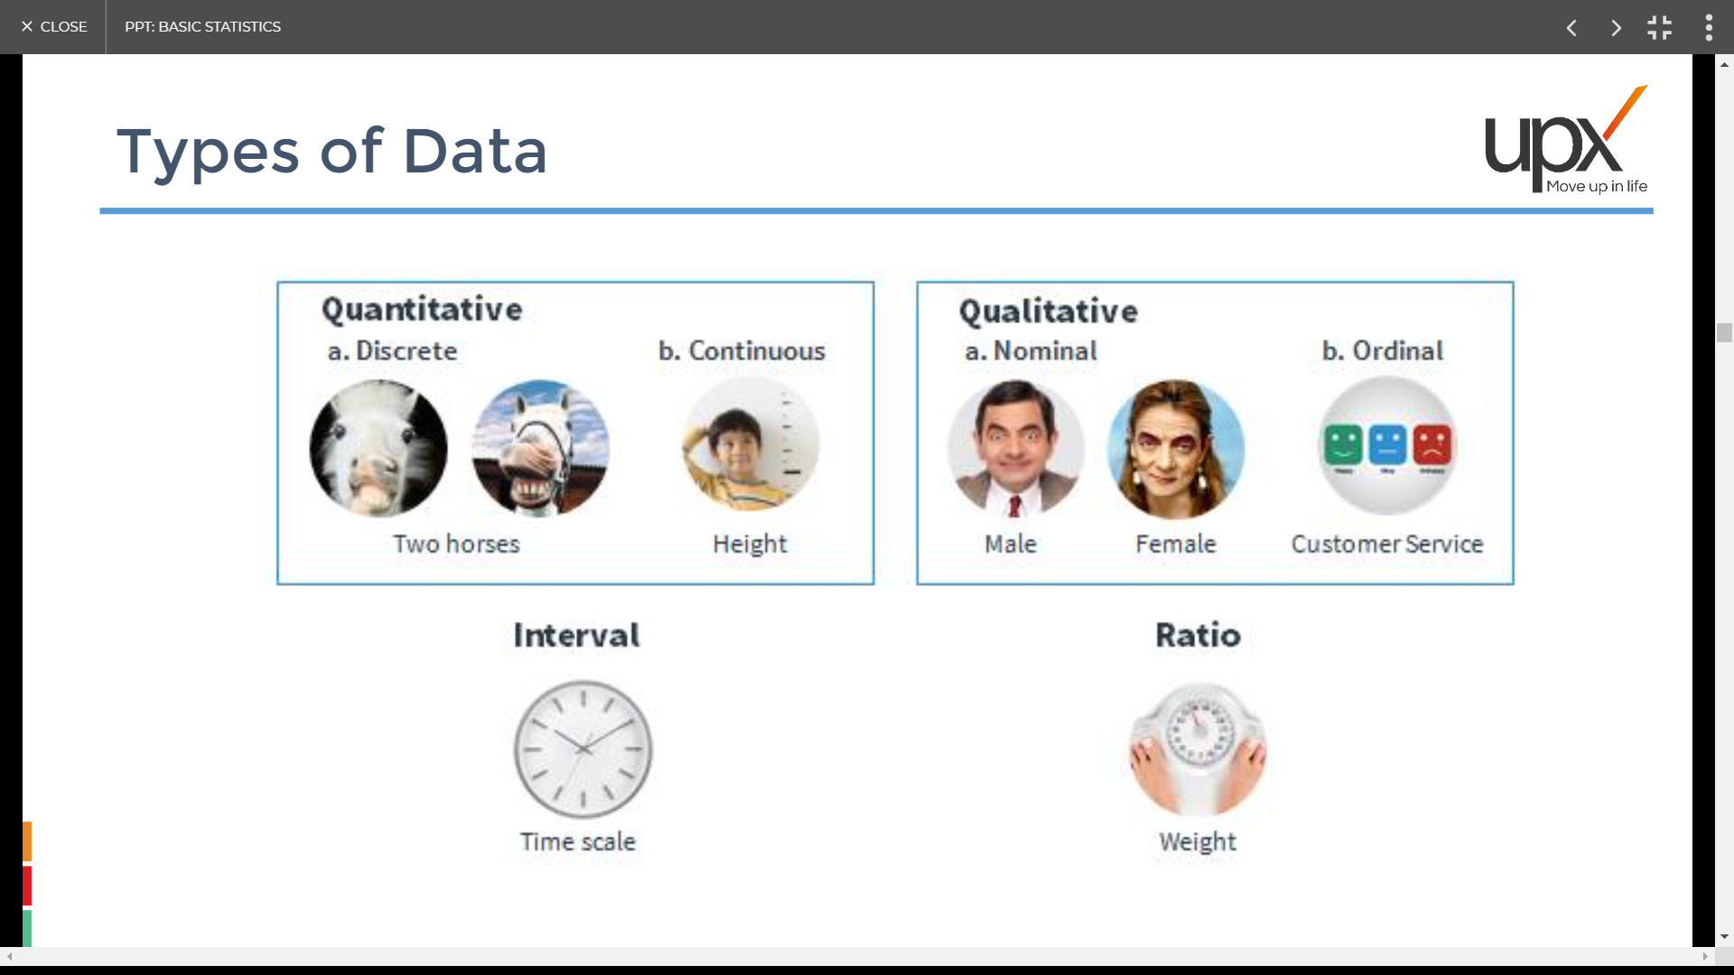
Types of Data

Slide 28
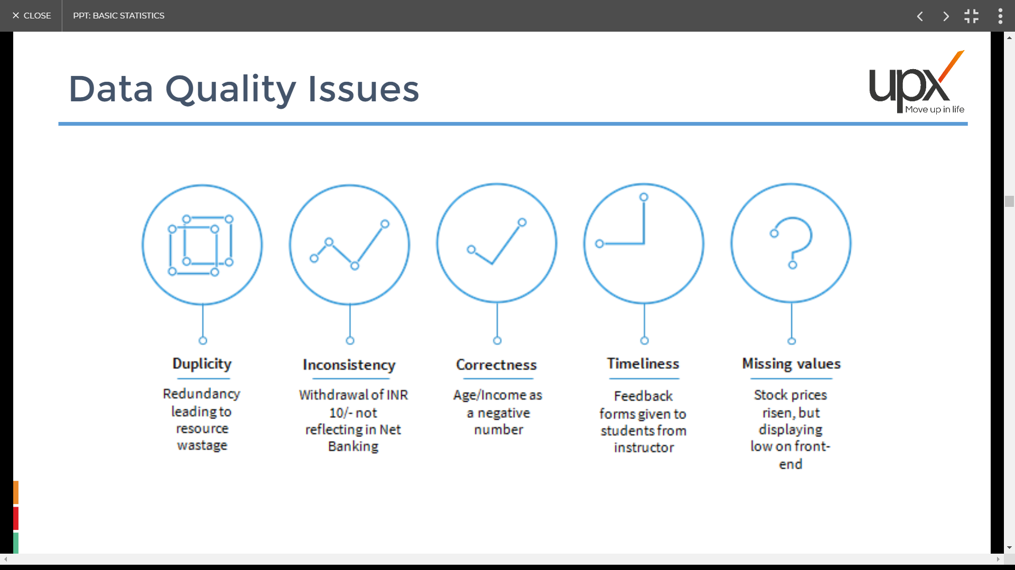
Data quality issues

Slide 29
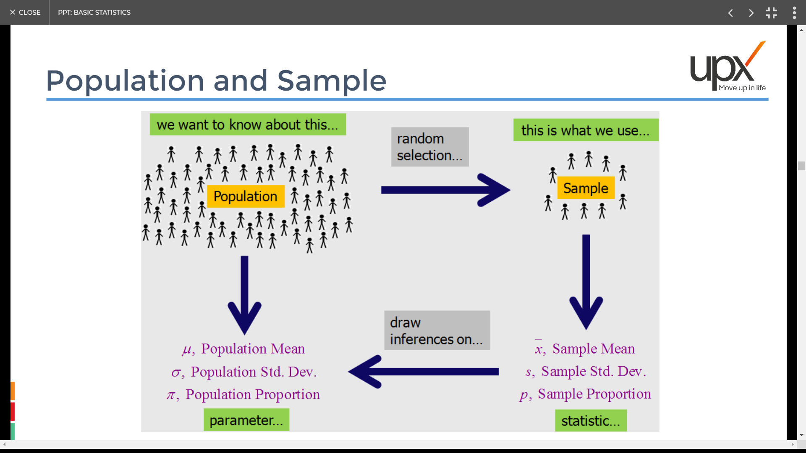
Population & Sample

Slide 30
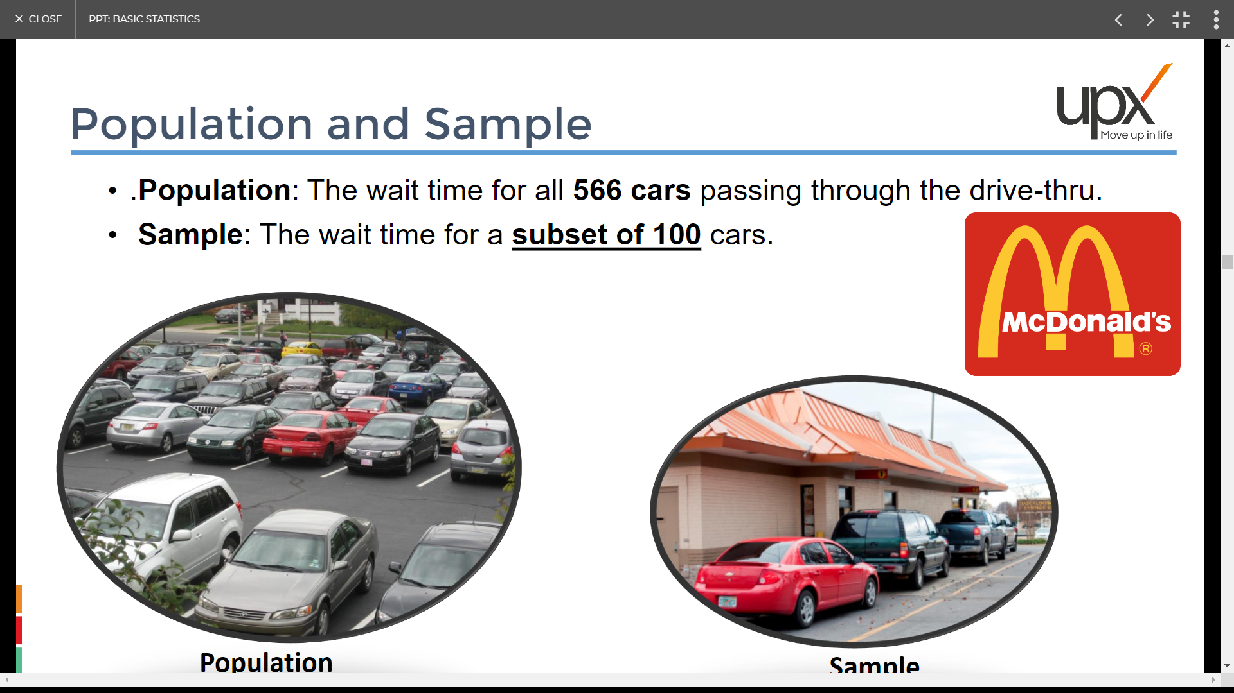
Population & Sample
Population
Sample

Slide 31
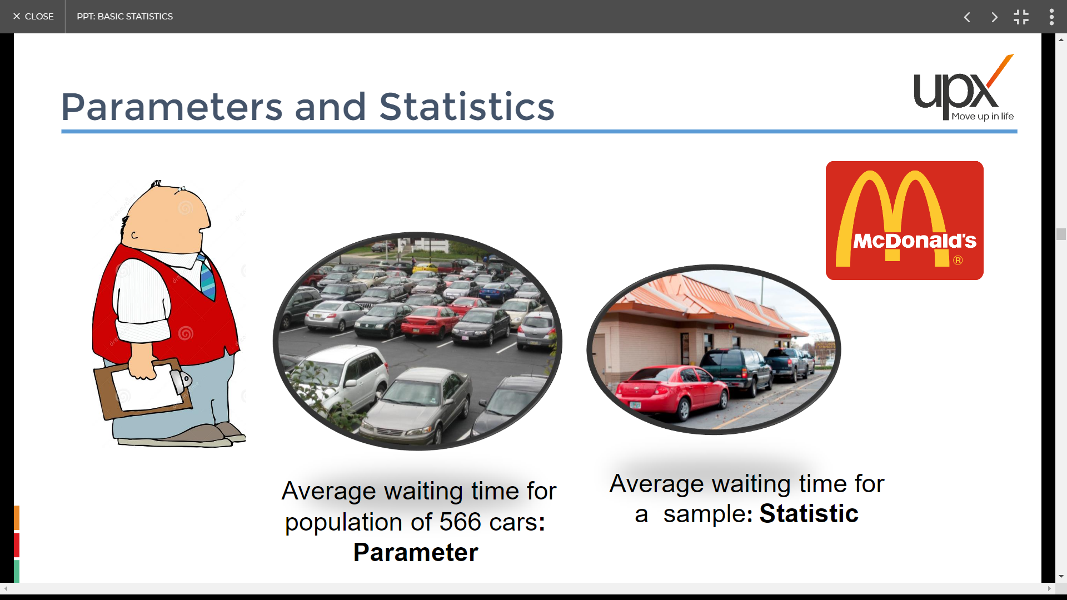
Parameters & Statistics

Slide 32
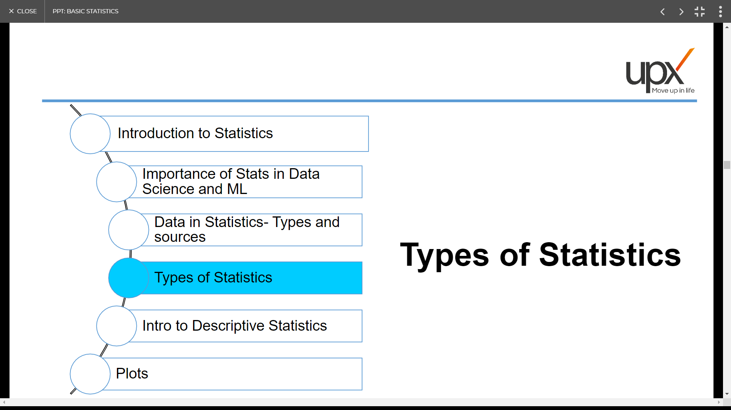

Slide 33
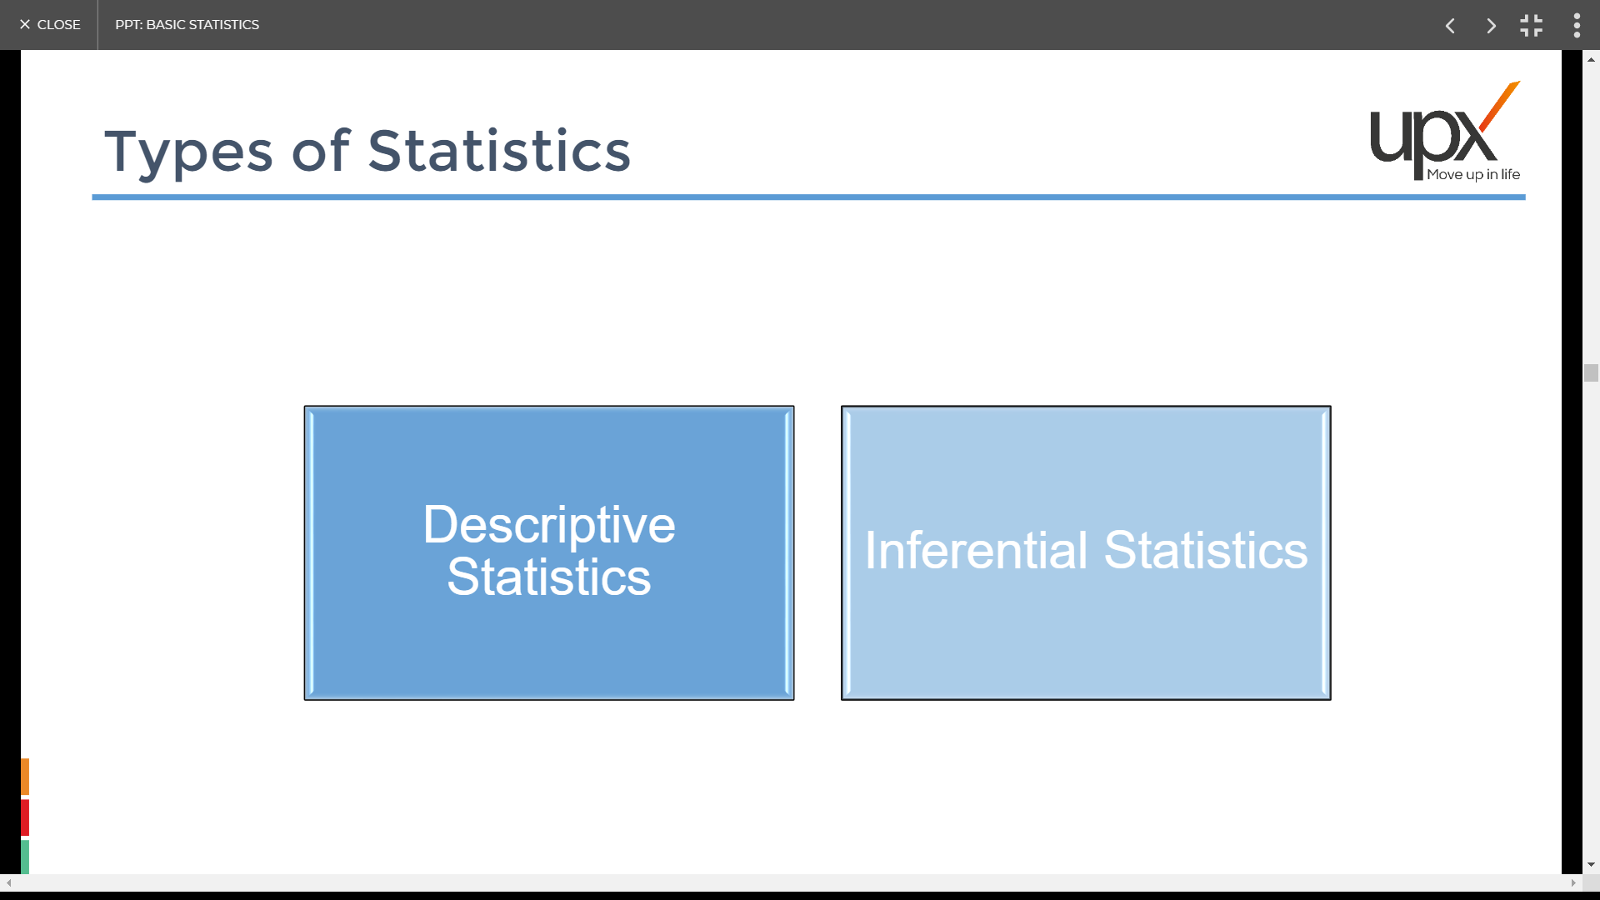
Types of Statistics

Slide 34
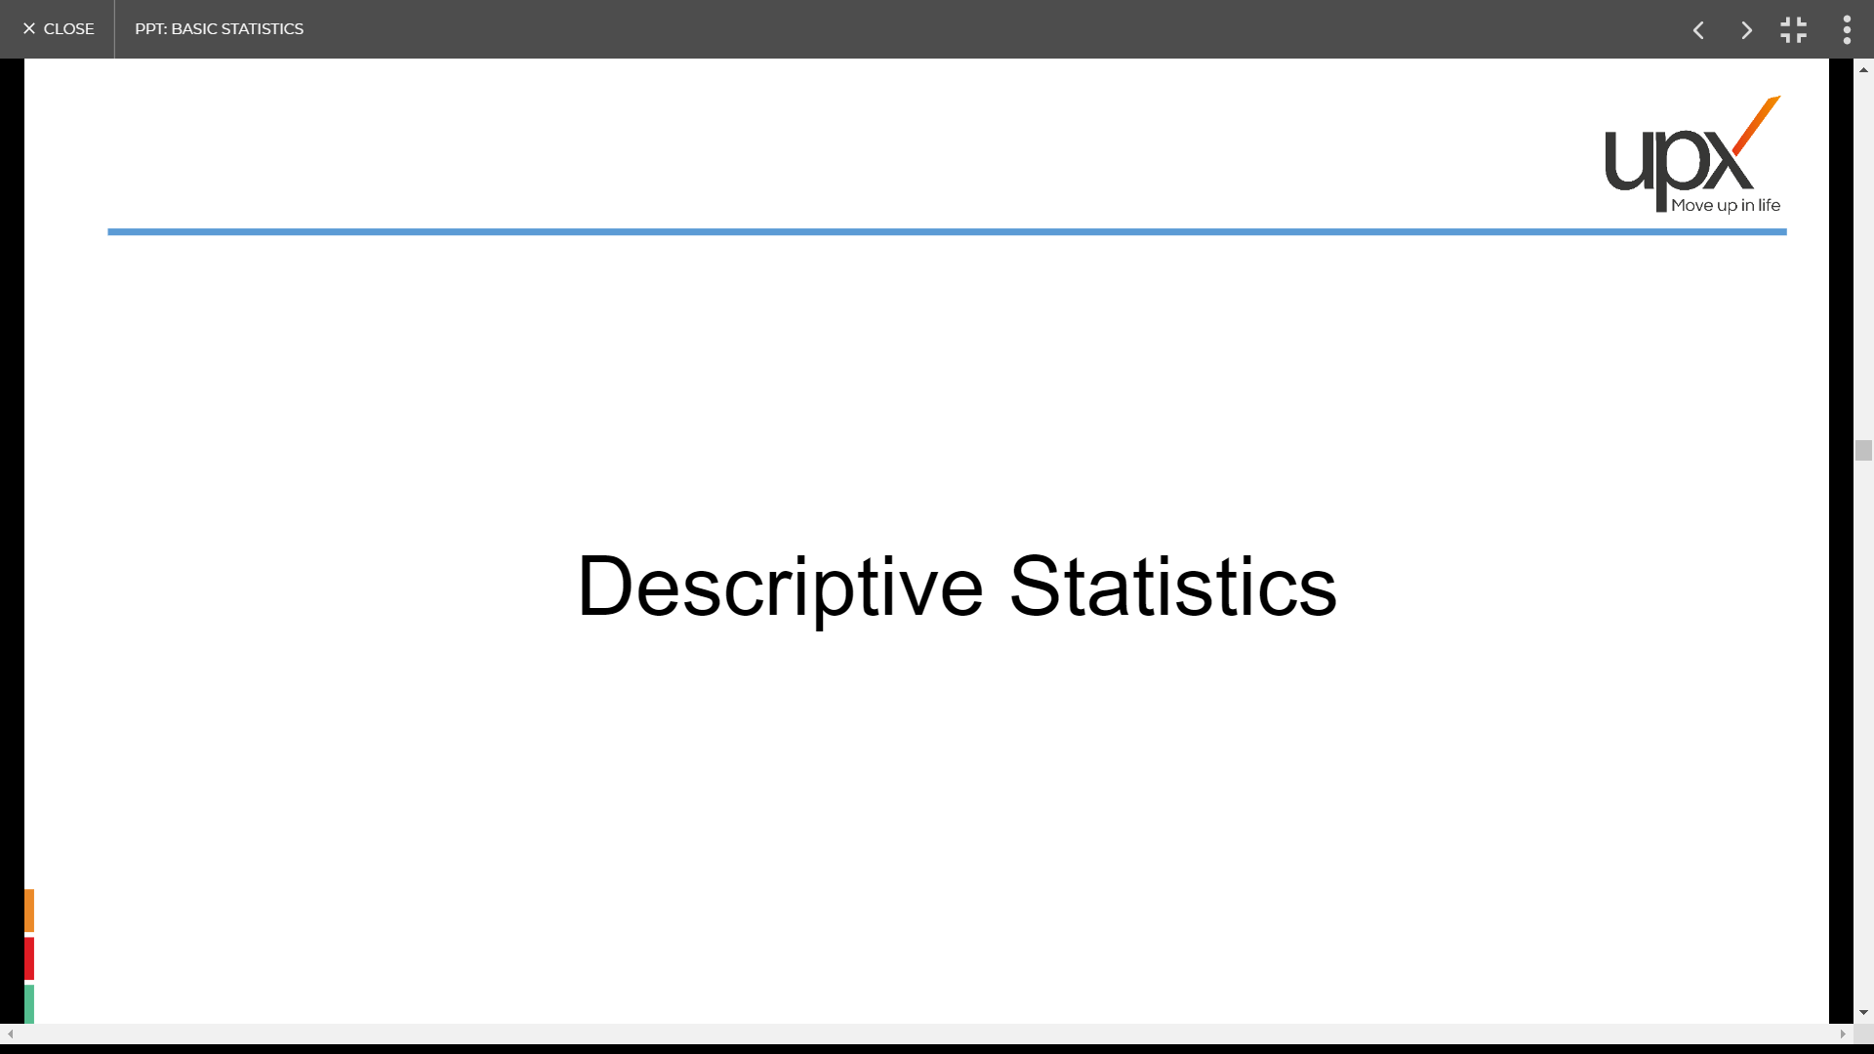

Slide 35
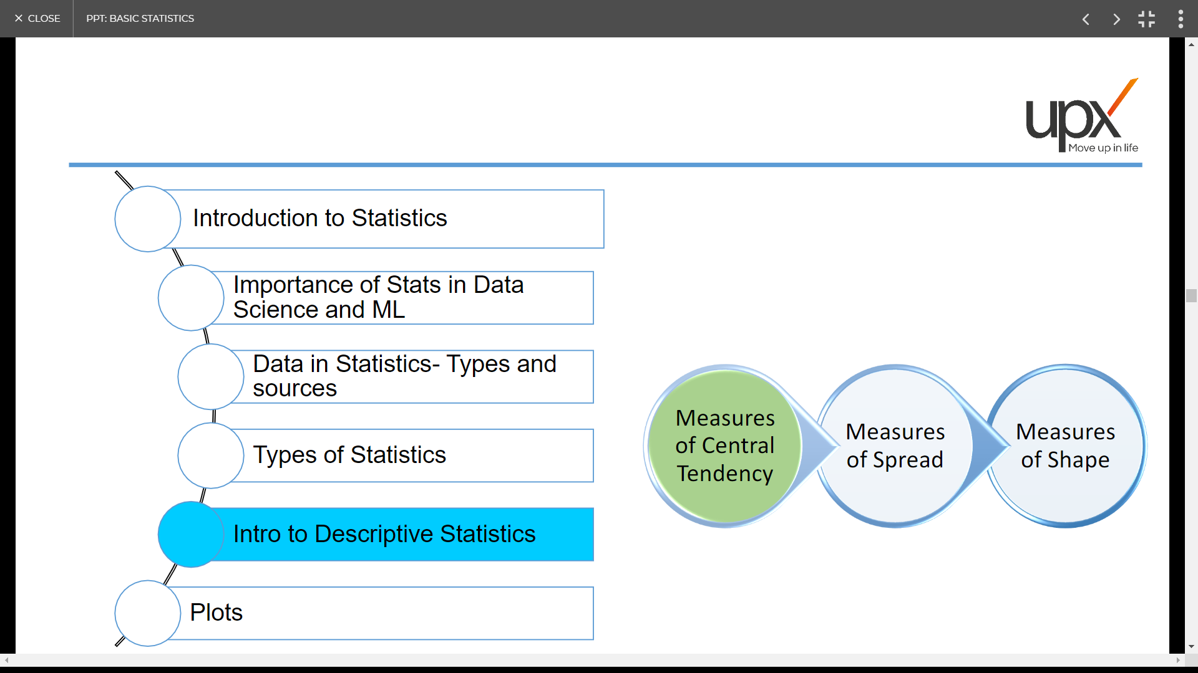

Slide 36
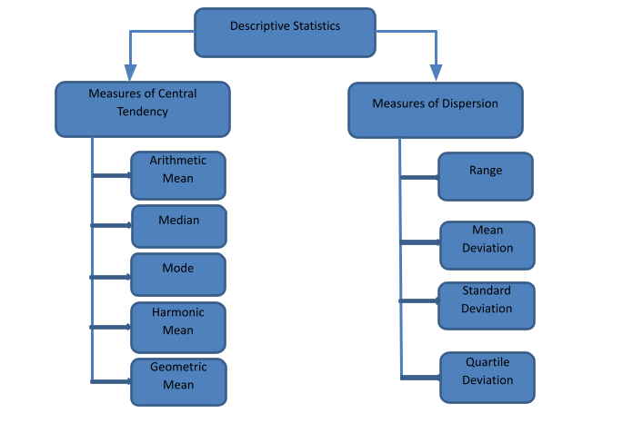
Measures of Central Tendency

Slide 37
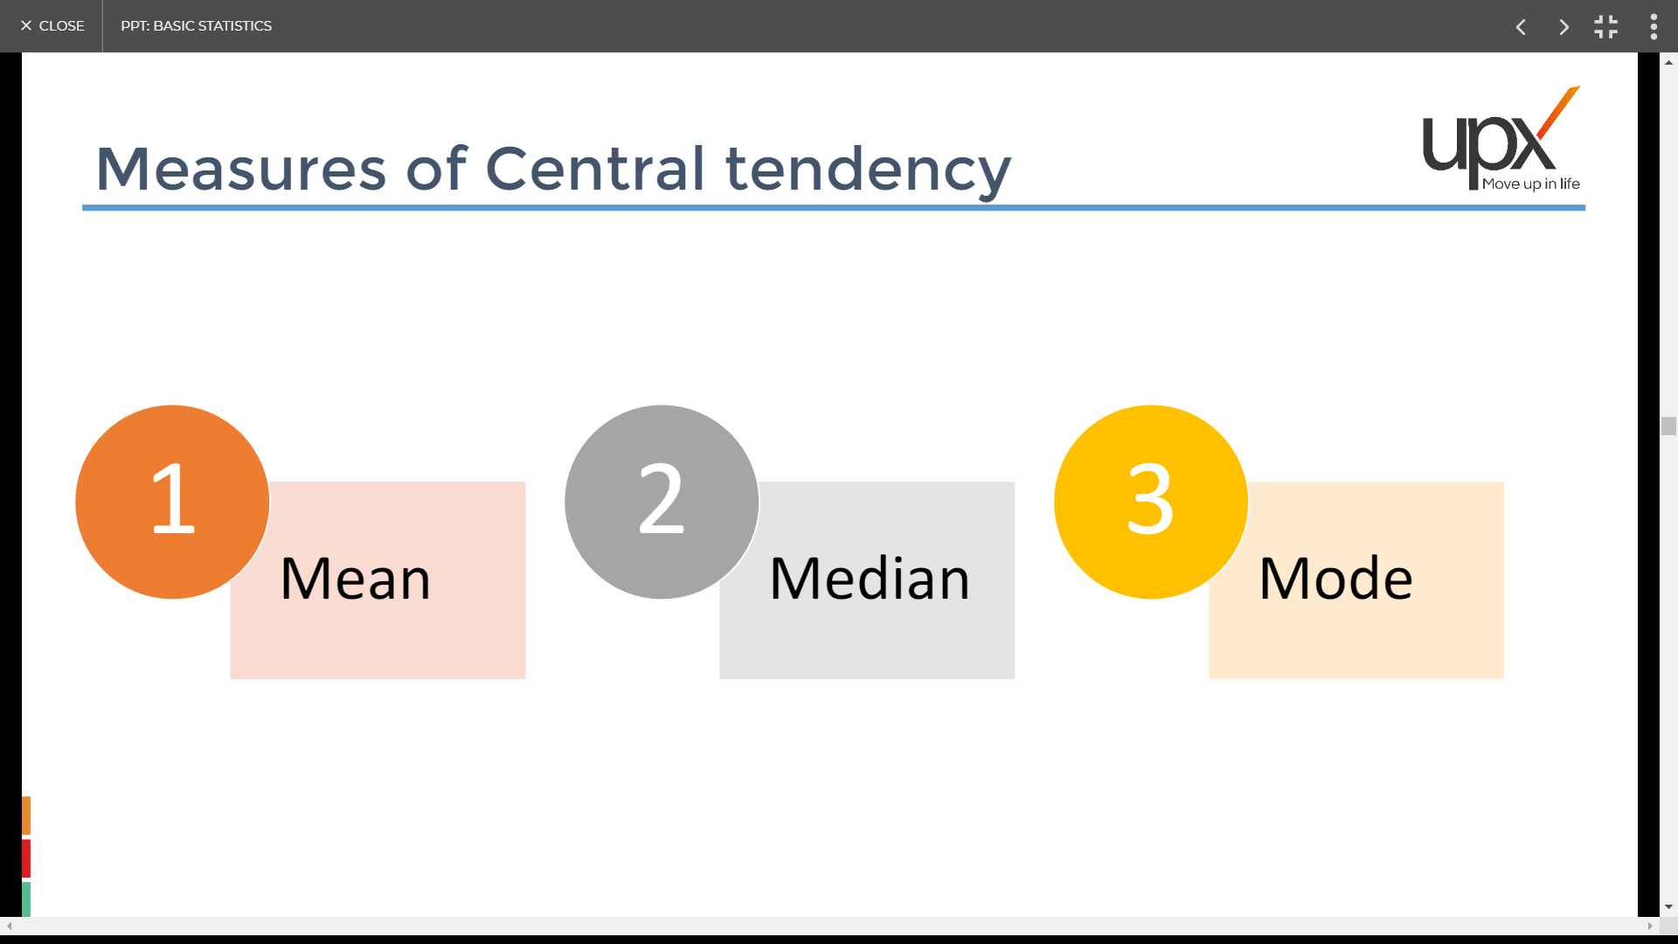
Measures of Central Tendency

Slide 38
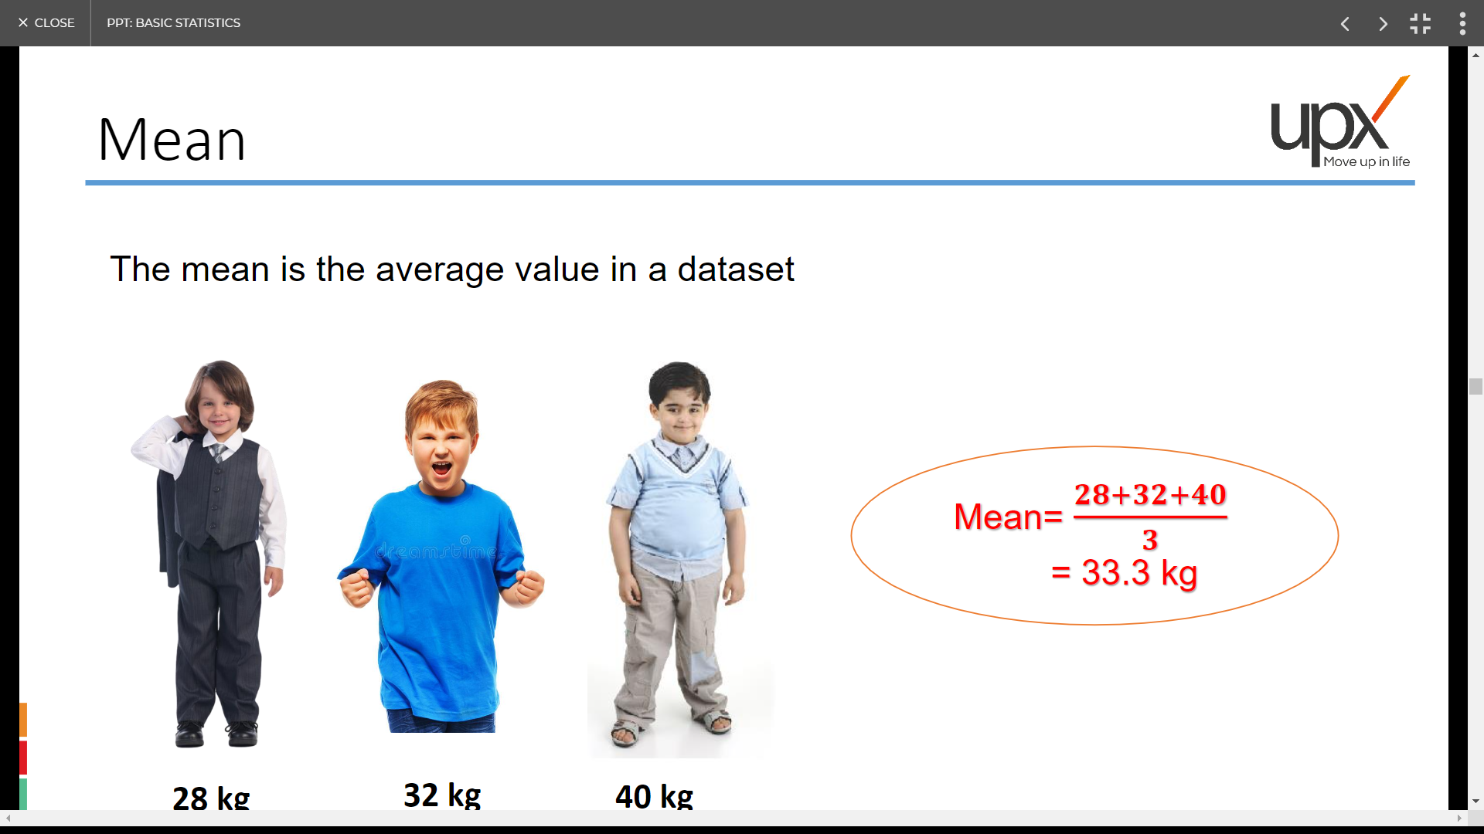
Mean
28 kg
32 kg
40 kg

Slide 39
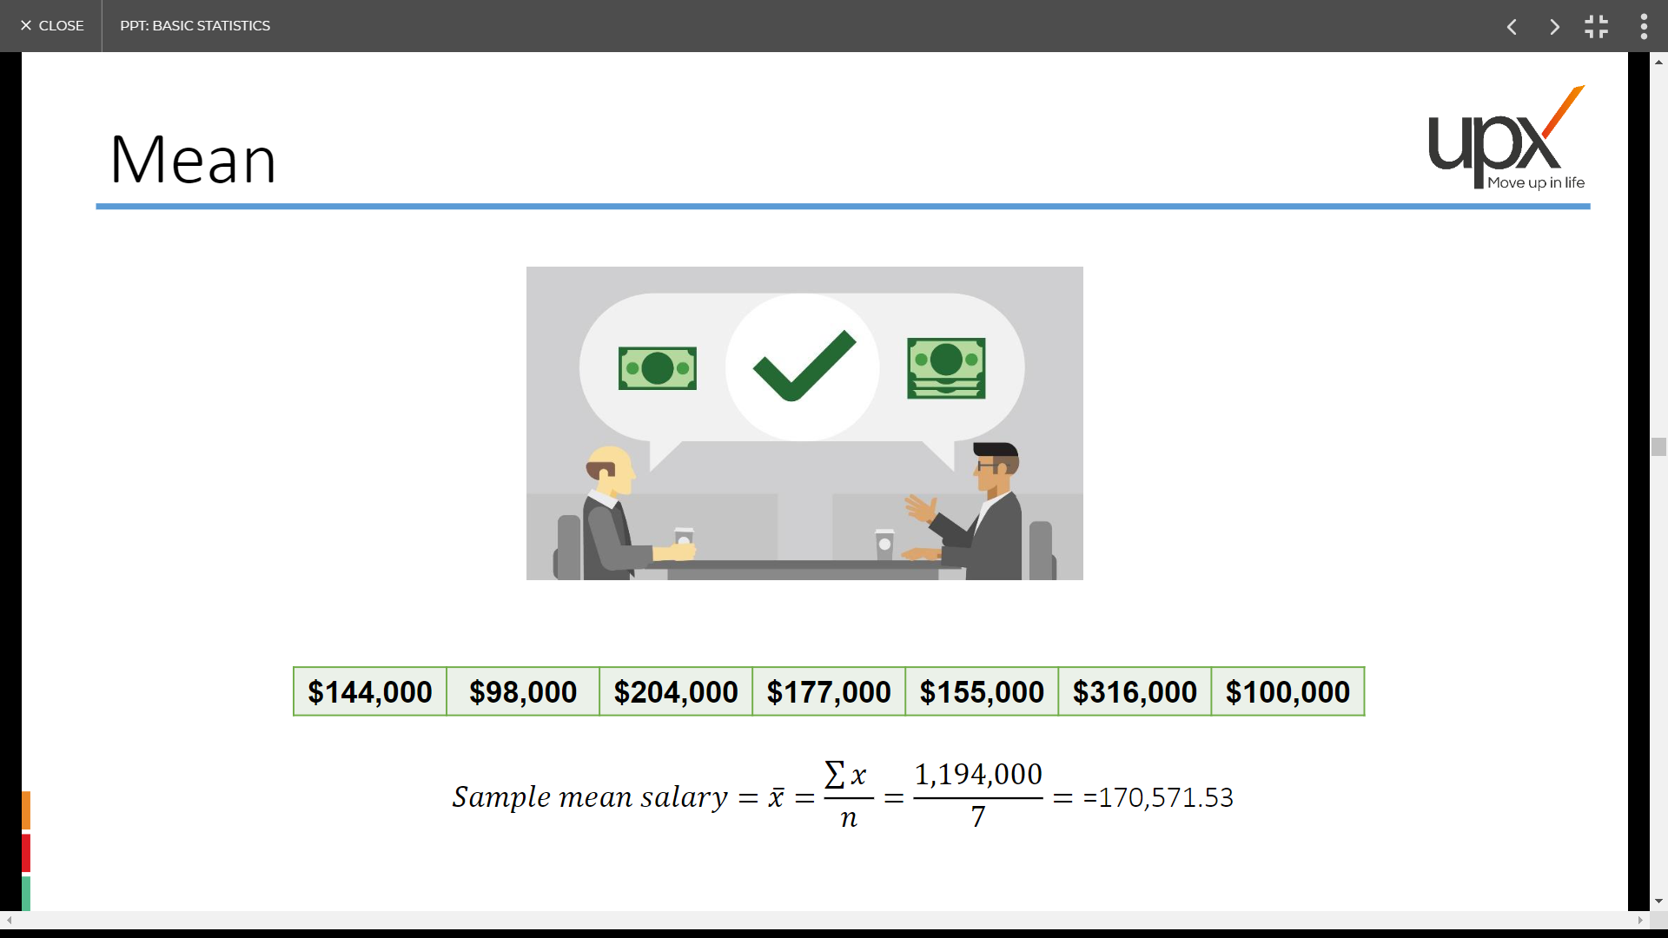
Mean

Slide 40
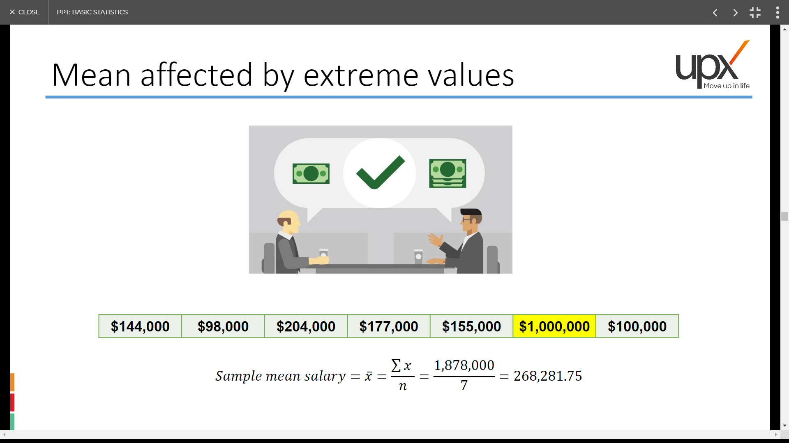
Mean affected by extreme values

Slide 41
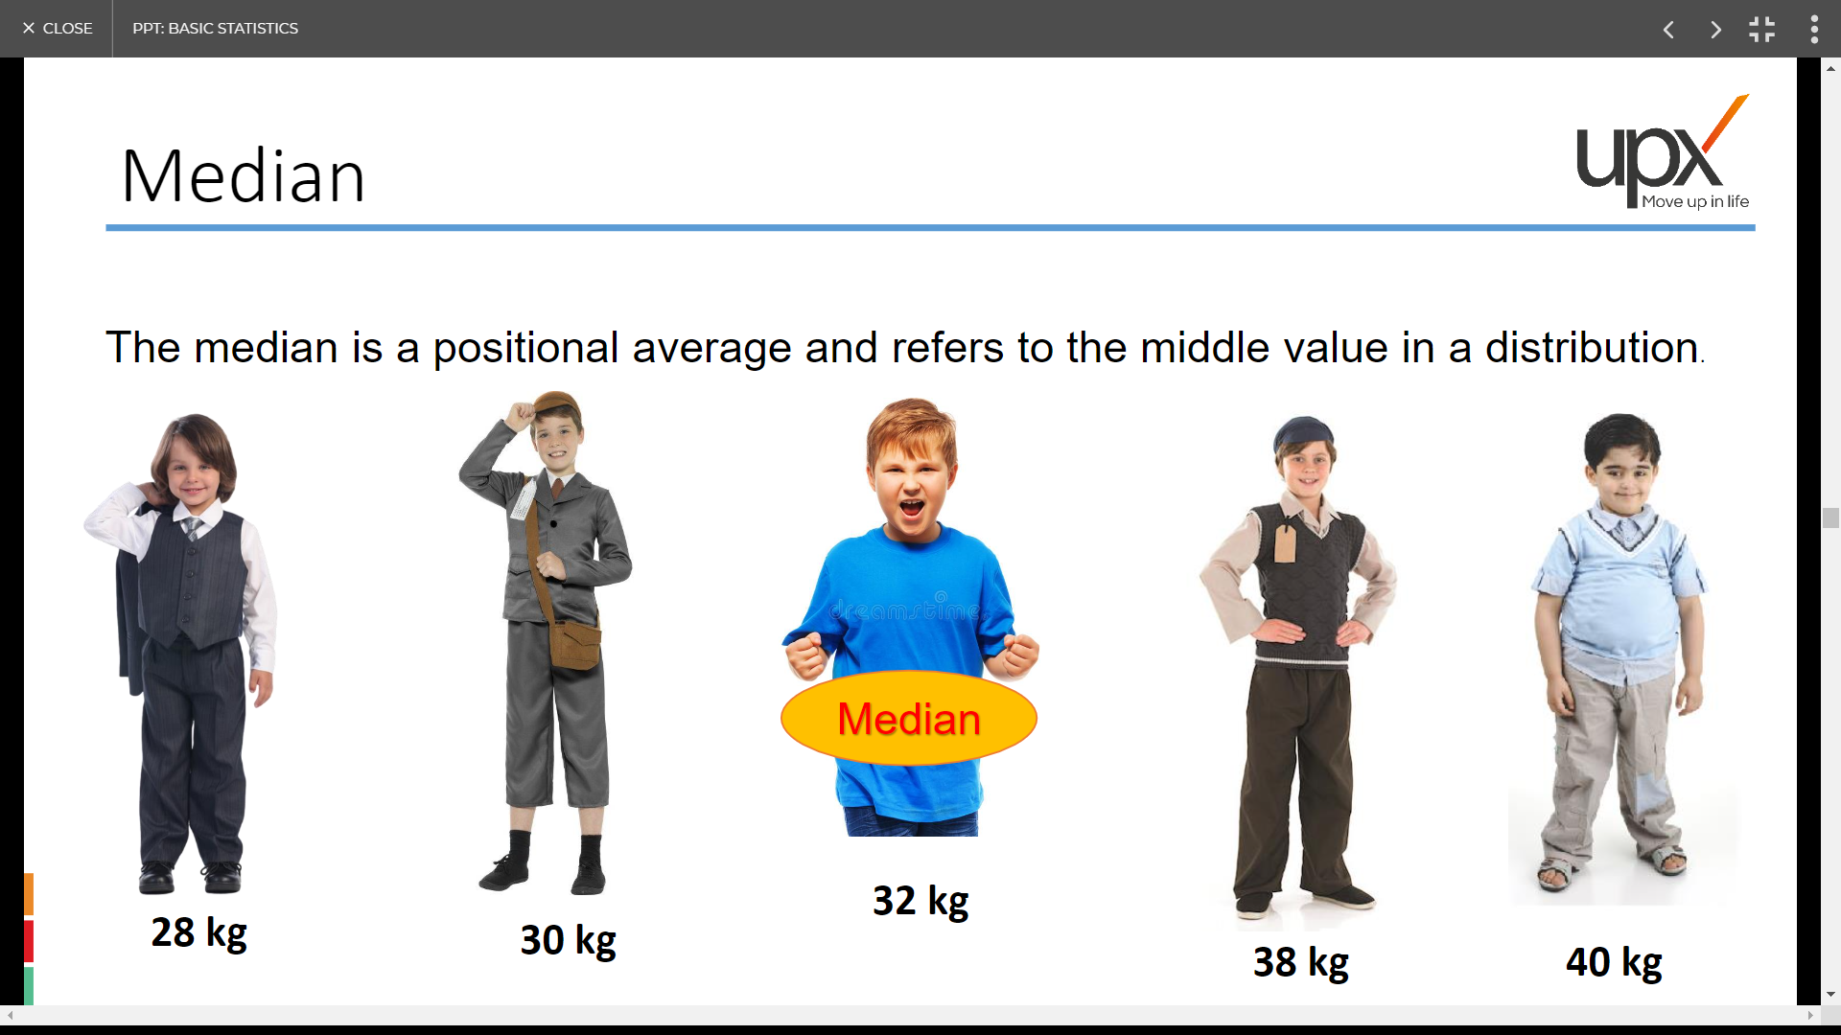
Median

Slide 42
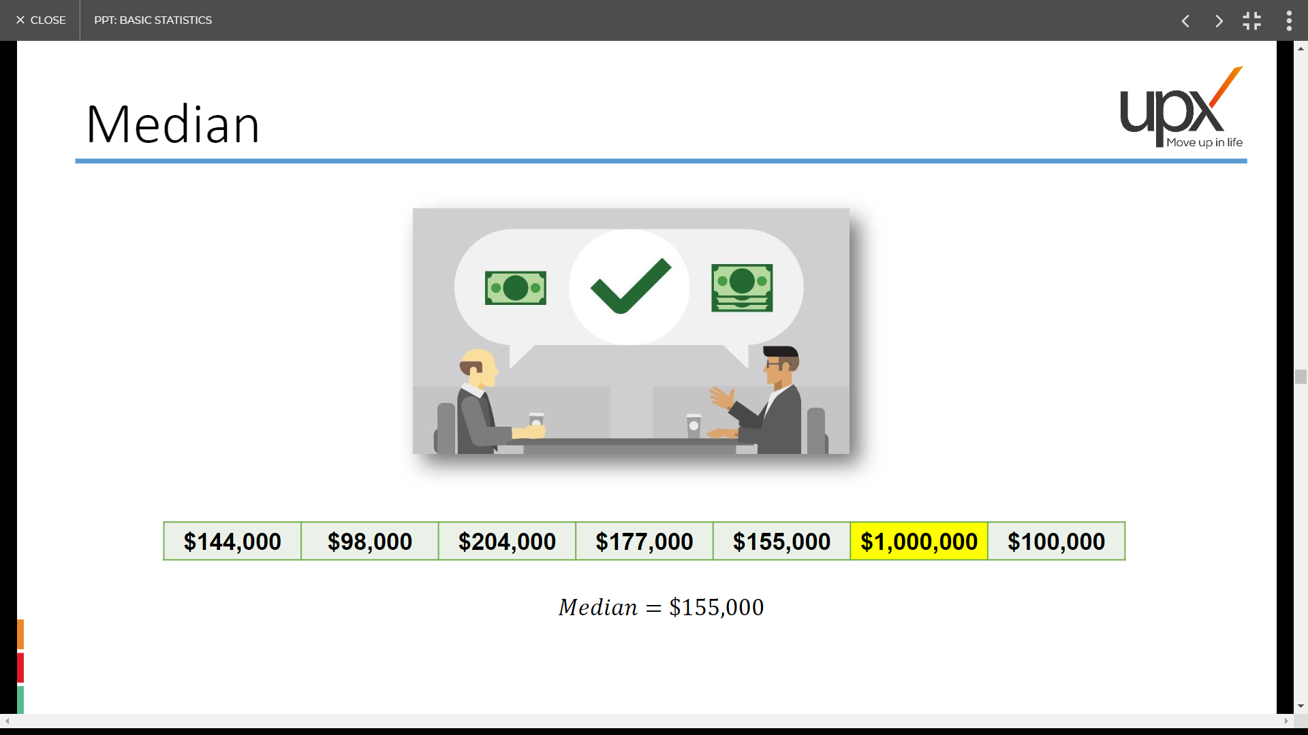
Median

Slide 43
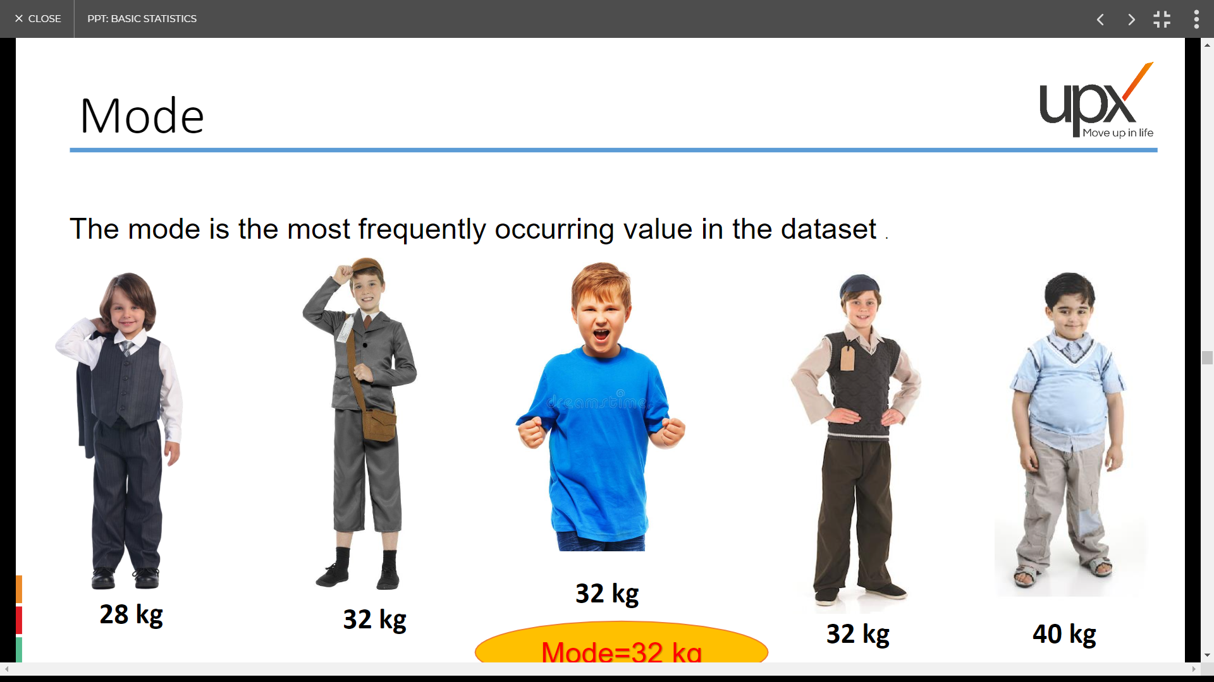
Mode
Mode=32 kg

Slide 44
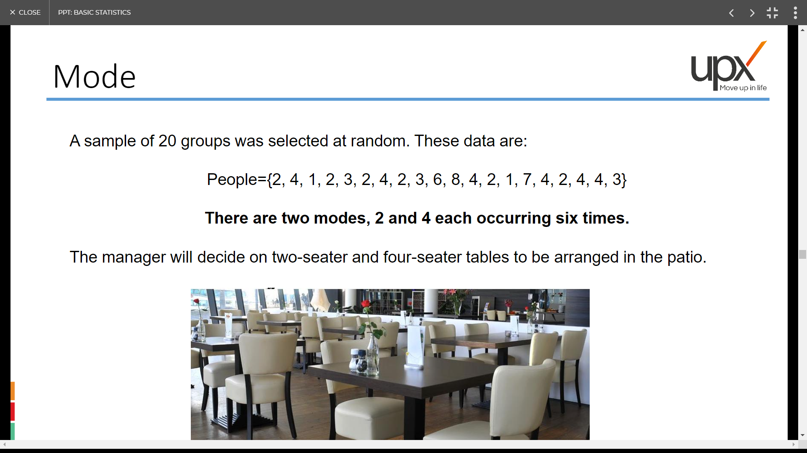
Mode

Slide 45
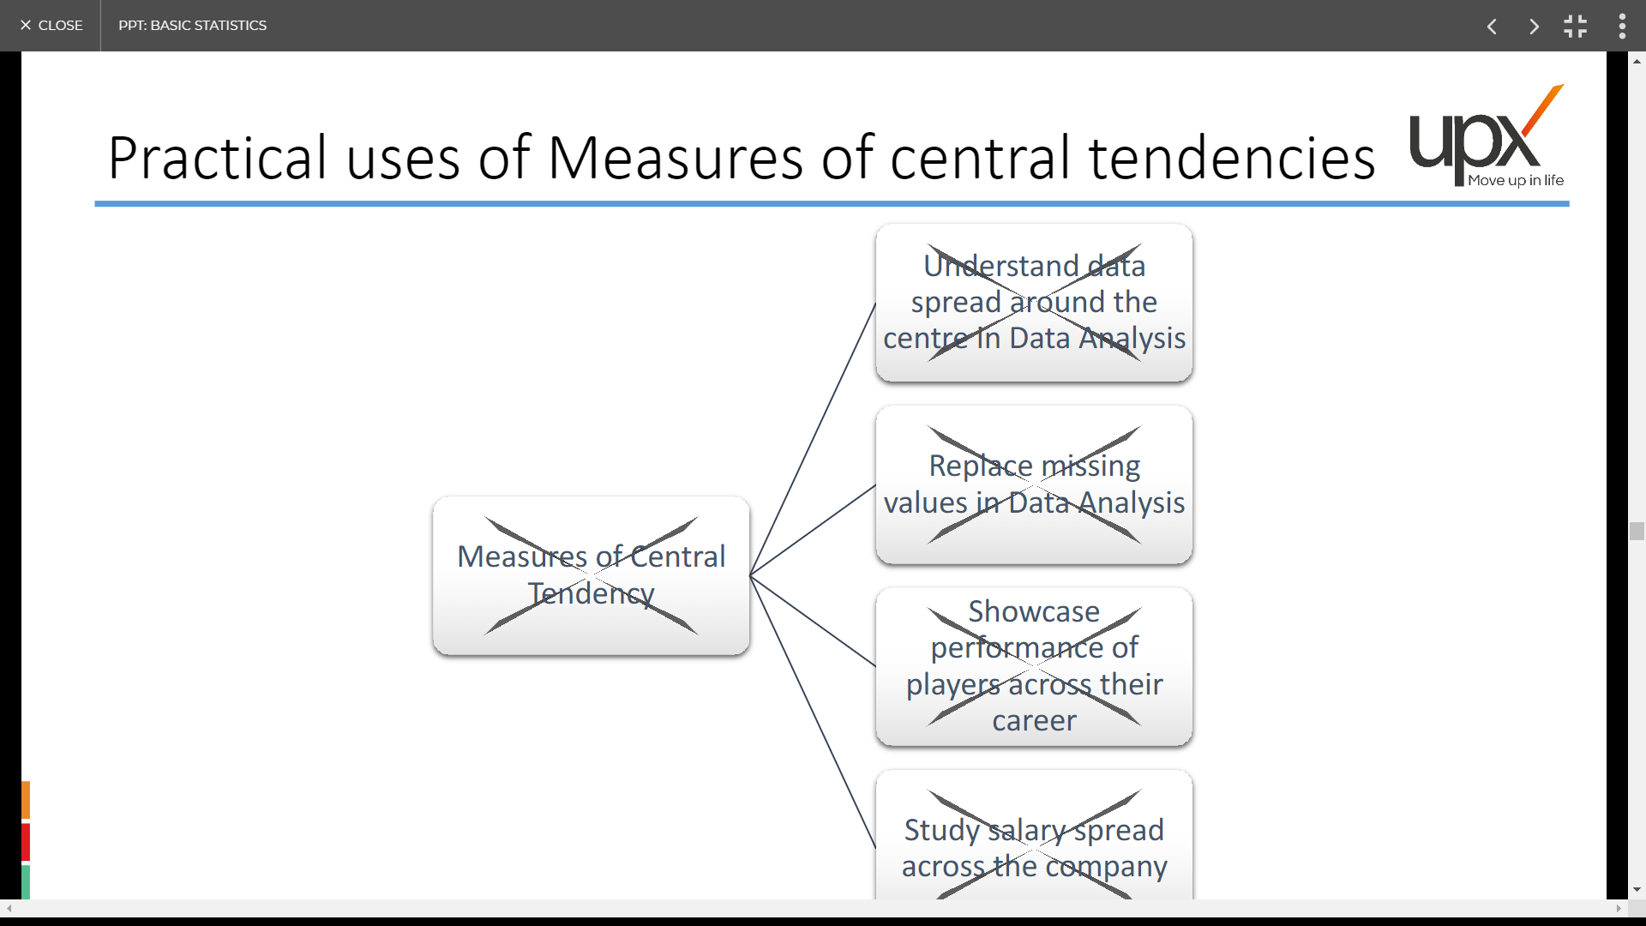
Practical uses of Measures of central tendencies
Understand data
Spread around the
Centre in Data Analysis
Replace missing
Values in Data Analysis
Measures of Central
Tendency
Showcase
Performance of
Players across their
career
Study Salary Spread
Across the company

Slide 46
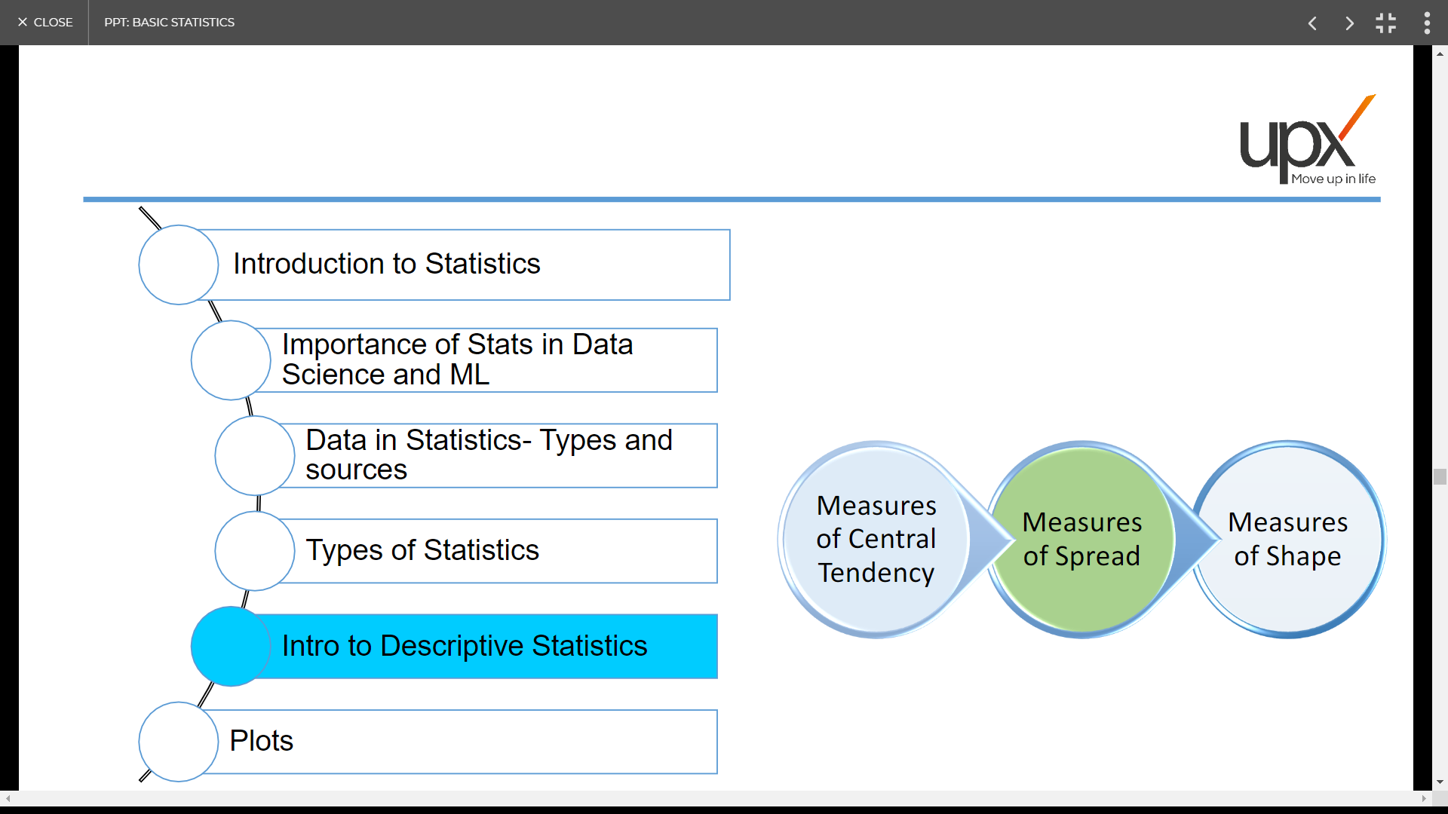

Slide 47
What is the mean of the following numbers: 1,1,1,2,4,5,5,5,7,8,12
Mean gives distorted picture of the data due to the presence of :
a) missing value b)low value c)High Value d) Extreme Value
3. Is it possible to have no mode of the data?

Slide 48
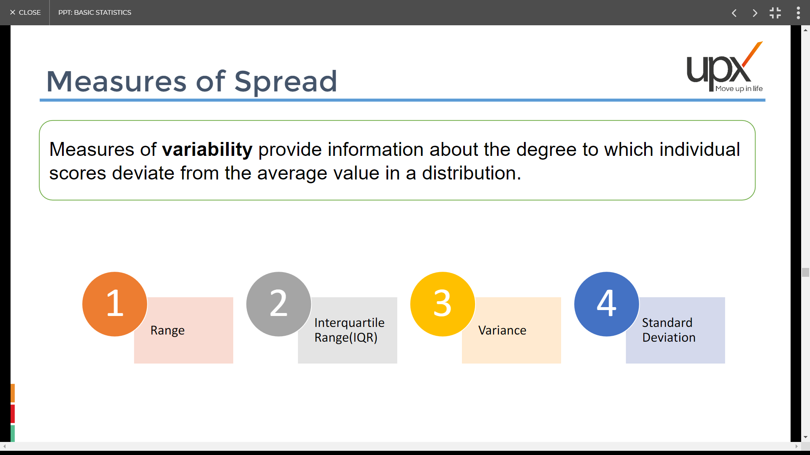
Measures of Spread

Slide 49
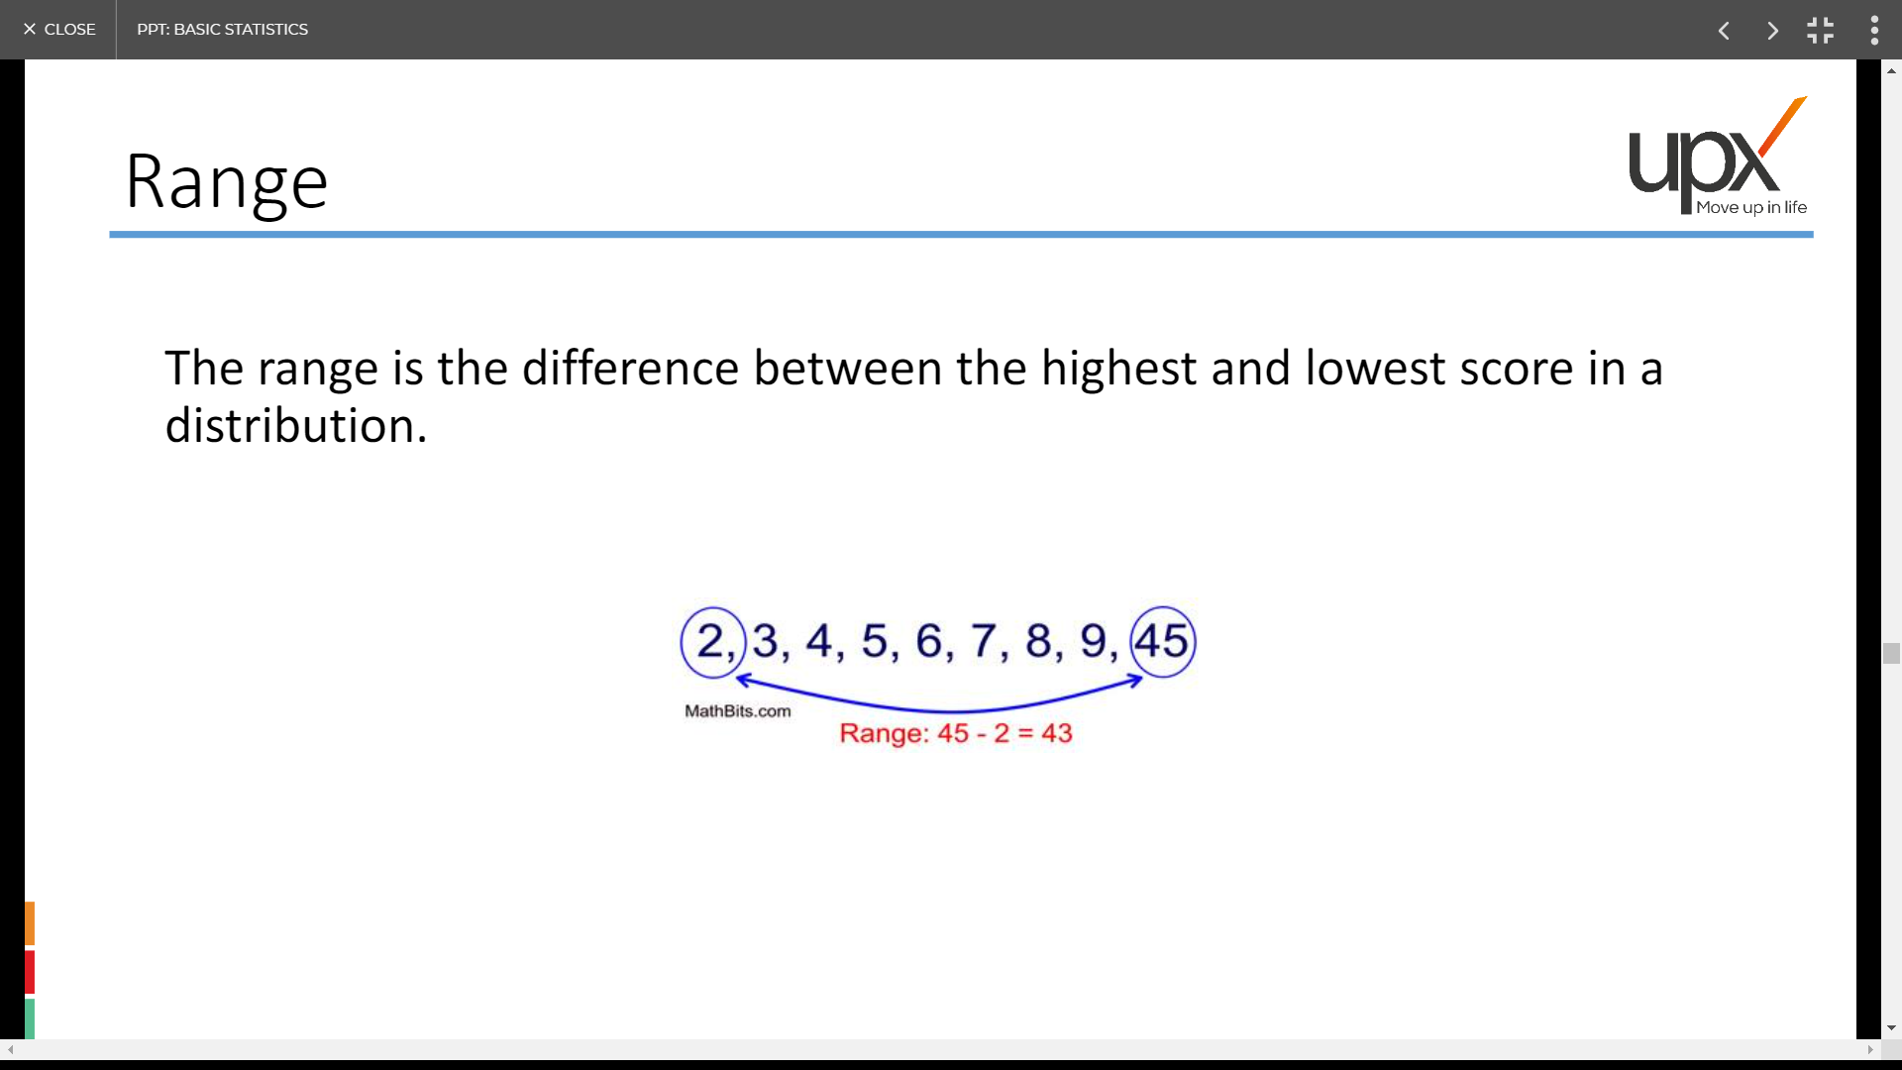
Range

Slide 50
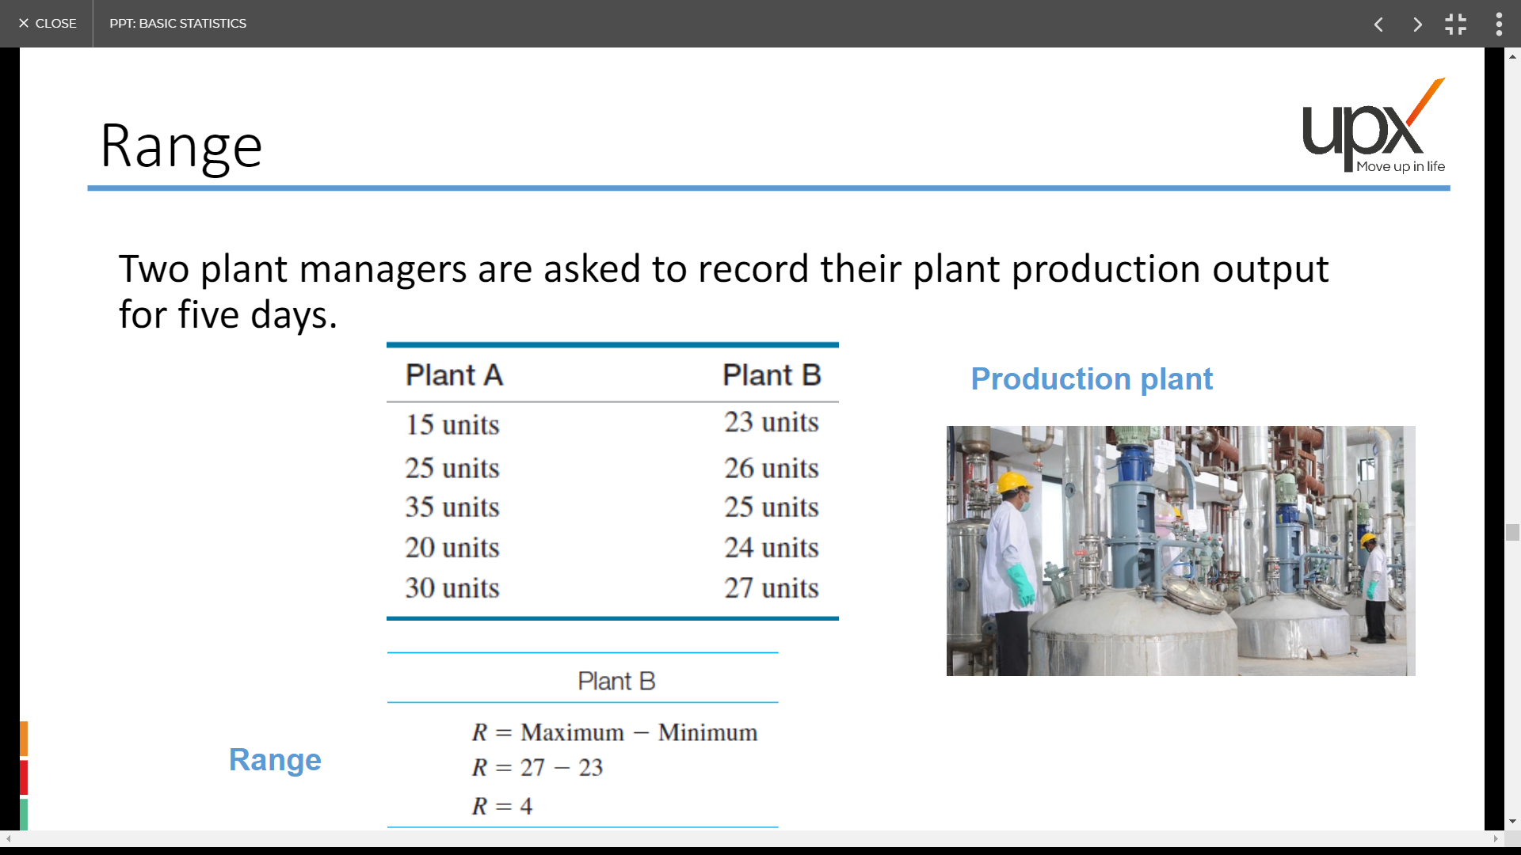
Range

Slide 51
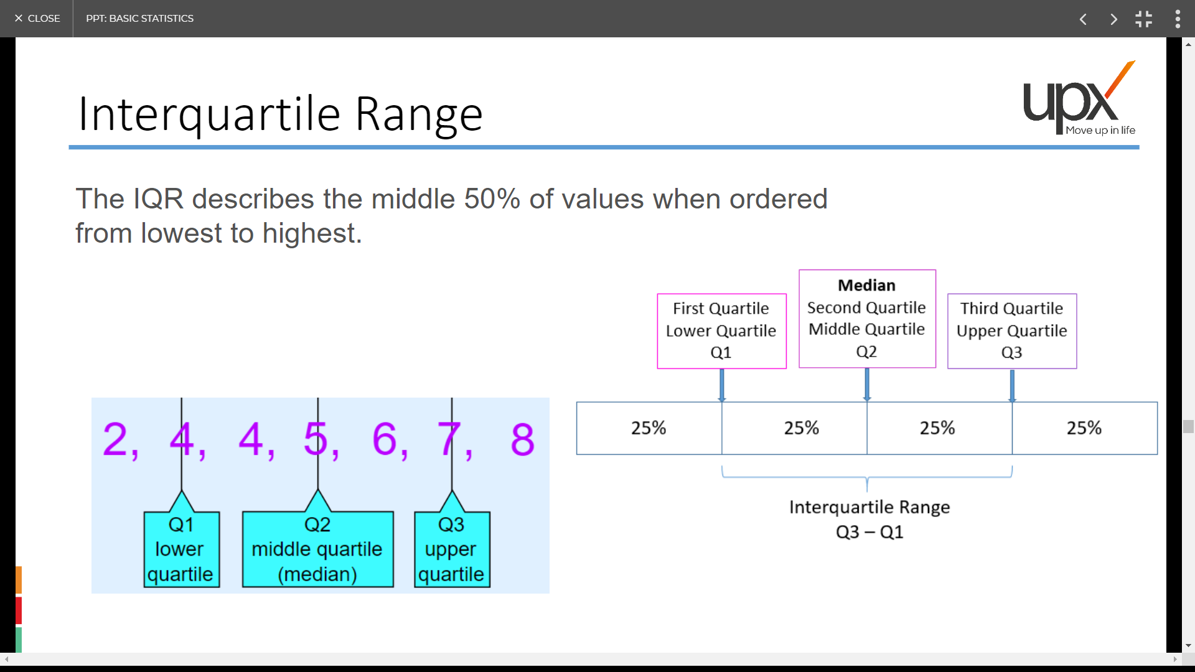
Interquartile Range

Slide 52
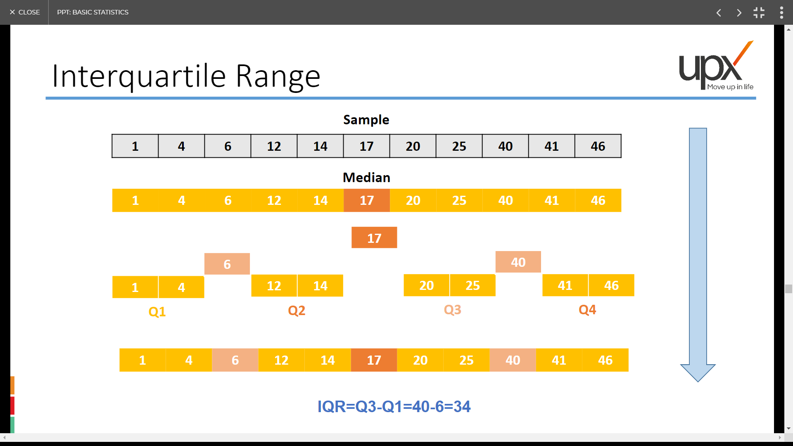
Interquartile Range

Slide 53
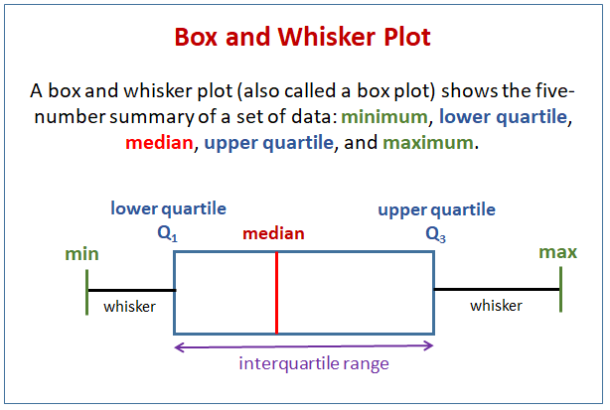
Interquartile Range

Slide 54

Variance

Slide 55

Standard Deviation

Slide 56

Standard Deviation

Slide 57

Standard Deviation

Slide 58

Standard Deviation Formula
Why n-1 is the sample std calculation?
Link: https://math.stackexchange.com/questions/15098/sample-standard-deviation-vs-population-standard-deviation

Slide 59

Practical uses of Measures of spread

Slide 60
Practice Question
Explain Box Plot and Outliers PPT
Python Handson

Slide 61
Q1: What is the std of the following Measurements : 4,4,4,4,4
Options: a) 0 b) 1 c) 4 d) 0.5
Q2: The sum of squared deviation of the measurements with their mean divided by
number of measurements is called
Options: a) variance b) std c) Mean d)None

Slide 62


Slide 63

Measures of Shape

Slide 64

Symmetric

Slide 65

Skewness

Slide 66

Kurtosis
It measures how fast the tails are approaching to zero or the fatness of the tails.

Slide 67

Kurtosis

Slide 68

Practical uses of Measures of Shape

Slide 69


Slide 70

Plots

Slide 71

Frequency Distribution

Slide 72

Histograms

Slide 73

Histograms

Slide 74

Bar Charts

Slide 75

Scatter Plots

Slide 76

Pie Chart

Slide 77

Box Plots

Slide 78

Box Plots

